Slide 1
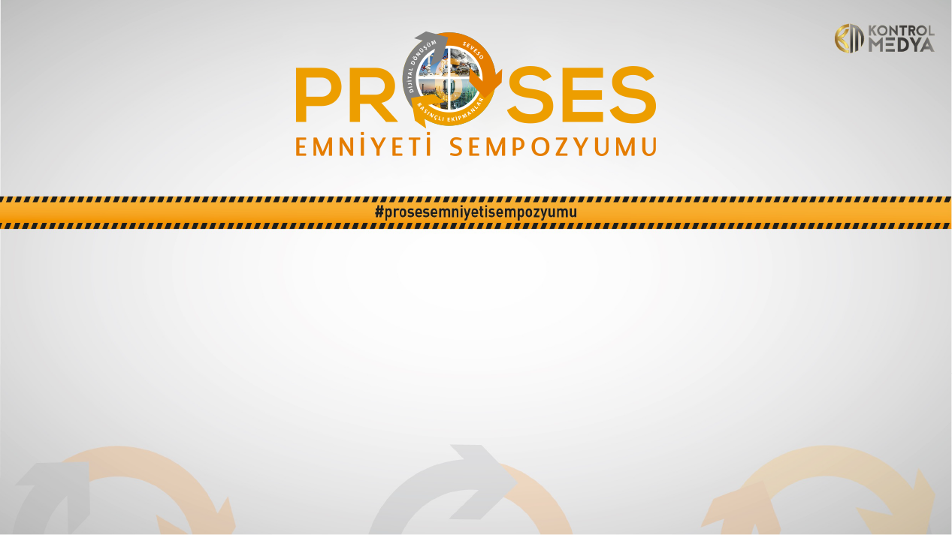
Artificial intelligence application example in Process Industry with PIMS
(Plant Information Management System)
Mr. Eberhard Klotz
Global Sales Director I4.0/Digitalisation
17.05.2022

Slide 2


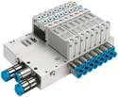

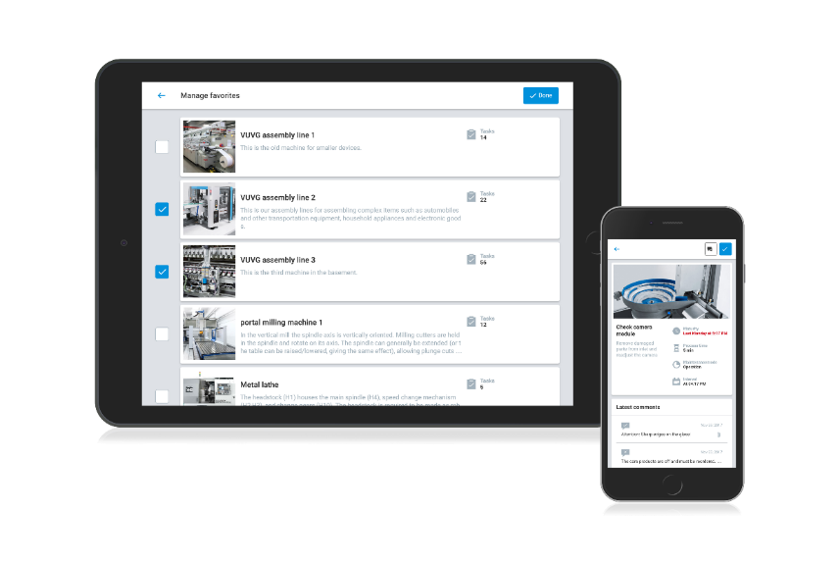



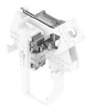




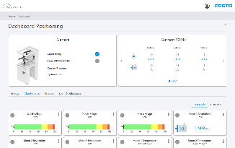


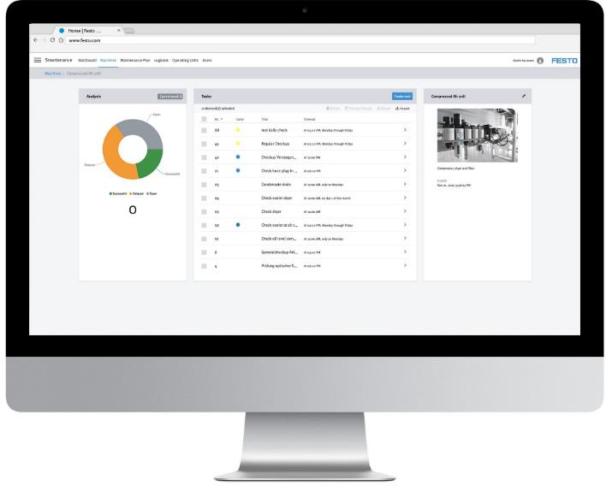
Festo – an independent family business
Products
Industry Segments (Examples)
Service
Factory Automation
Process Automation
Digital Business
> 10,000 customised solutions a year
Pneumatic
Electric
Pneumatic
Data
Components
Food & beverage
Automotive
> 24 h delivery service
> 176 countries with Festo presence
AI
Oberflächen/
Halbleiter
Electronics
Solutions
> 100 patents per year
Water technology
Biotech / Pharmaceuticals
> 35.000 Products/10⁴⁰ Variants
> 300.000 Customers
> 20.000 Staff
No.1 in intelligent
automation / valve terminals
No.1 in industrial
training and consulting
>3.4 bn euros turnover
Notes:
Ergänzung Nr.1 in Ventilinseln + Training als Überleitung zu I4.0
➔ deshalb haben wir neue / bessere Antworten ☺

Slide 3
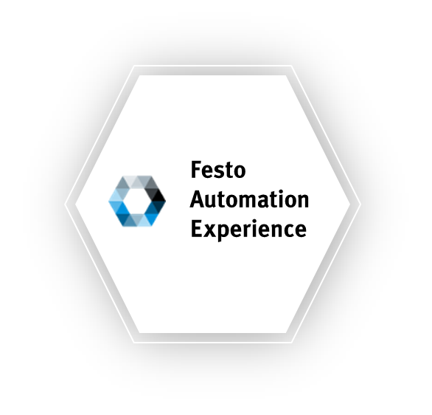



Festo AX – The automation industry needs AI
#higherproductivity by leveraging AI, IoT and Edge (or Cloud) Computing
Continuous monitoring and analysis
of relevant data for anomaly detection
to optimise production

Slide 4




Festo AX – The automation industry needs AI
#higherproductivity by leveraging AI, IoT and Edge (or Cloud) Computing
Solutions for improving OEE
Predictive quality Improves overall production quality by continuously monitoring and analysing production data and detecting quality issues | Predictive energy Optimises energy usage by continuously monitoring and analysing energy consumption as well as detecting anomalies | Predictive maintenance Predicts failures and reduces unplanned downtime by continuously monitoring and analysing asset data | Smartenance Supports all maintenance activities in a cloud-based application. Offers an API for seamless connectivity and a mobile app for the shop floor communication
Operations processes |  | Maintenance processes

Slide 5





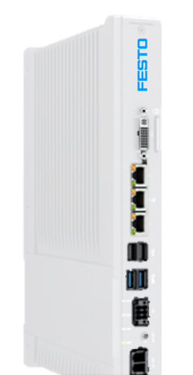






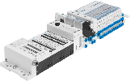

















Seamless Connectivity from the workpiece to the cloud as a basic ingredient for success
A virtually unlimited range of solutions for industrial automation tasks, supported with innovative software for engineering and configuration
Motion Control and Software
Digitalisation
Host- PLC
Host Integration
Rockwell, Siemens, Beckhoff
Festo Cloud
And Projects
HMI
CDPX
Engineering
Festo Automation Suite
IoT GW
CPX-E
SBSx
Software
Modules 2.0
On Edge/Prem
IO Terminals
Connectivity
PLC
Vision
Servo Drives
CMMT/EMCA
CMMT-ST
CMMT
CMMT-ST
CPX
I/O
DSNU
EMMB
Motors and
linear mechanics
I/O modules
PLC
Motors
DPDM
EMMT/S/E
ESBF
ERMO
CPX-E
Rotary modules
DGST
ELGC/EGSC
YXCx
Pneumatic Actuators
DGC
Linear axes
Standard solutions: Servo press kit & Handing systems
Cylinders

Slide 6


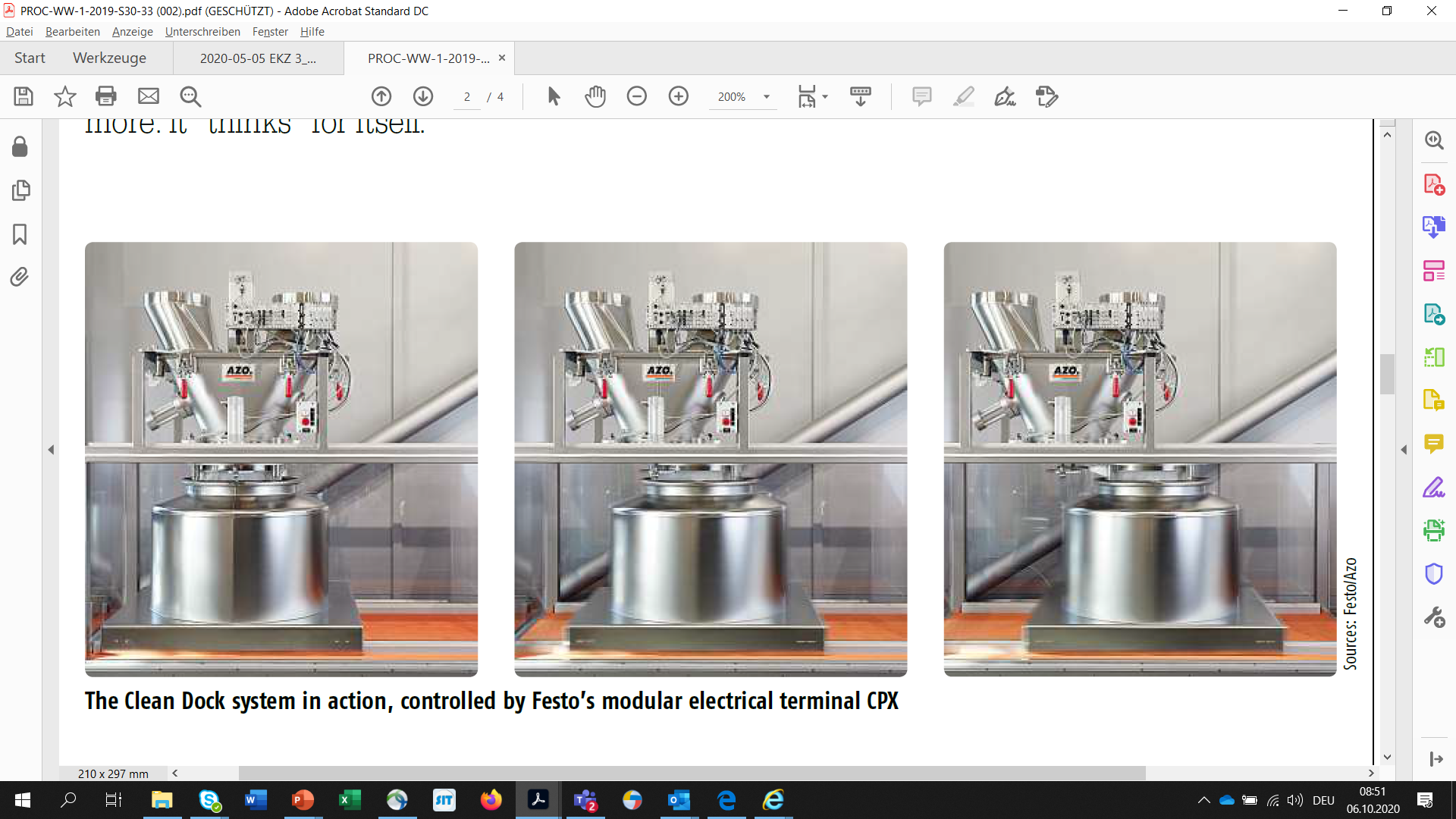









Seamless Connectivity - from measured value to added value: Domain know-how needed
Industry 4.0 components
Digital Platform Dashboards
Value-added services
Digital copy
AI
Actions
Scanning
Produkt verbinden
IoT gateway/Edge
Analytics
AI
Saving
Transferring
AI
Compressing
Objectives
Status Dashboard
Trend analysis and early warnings
Automated error notification
Reading
Mounting
Building blocks for providing an I4.0 value-added service (edge? on-prem? cloud?)
Festo AX = IIoT Platform, AI, Visualisation, Workflows

Slide 7
Advantage AI? What actually is AI?
Artificial Intelligence (AI)
The generic term that summarises all technologies and methods that make up artificial intelligence.
Machine Learning (ML)
Systems are able to recognise patterns and laws on the basis of existing data and algorithms.
Deep Learning
The machine is able to improve its abilities independently and without human intervention.
Reinforcement Learning
The machine uses dynamic programming that trains algorithms using a system of reward and punishment to make own decisions.
Transfer Learning
The application of knowledge acquired by completing a task to contribute to the solution of another related problem.
Festo uses and supports all of them!
7
Notes:
There are many different terms being used on the topic of AI and I would like to start by classifying them from our point of view.
AI = Artificial Intelligence is the generic term that summarises all technologies and methods that make up artificial intelligence.
The following sub-concepts, when applied to industrial production, illustrate the different levels of complexity of the algorithms that are stored in the background:
Machine Learning means: with the help of machine learning, IT systems are able to recognise patterns and laws on the basis of existing data and algorithms and to develop solutions.
Deep Learning means: deep learning teaches machines to learn. The machine is able to improve its abilities independently and without human intervention.
Reinforcement Learning in the context of artificial intelligence means a kind of dynamic programming that trains algorithms using a system of reward and punishment. The agent makes decisions over time to maximise the reward and minimise the penalty through dynamic programming.
Meaning of Transfer Learning: transfer learning is the application of knowledge acquired by completing a task to contribute to the solution of another related problem.
However, for industrial production this is still a long way off.
Today we're primarily talking about Machine Learning.
What advantage does AI have over the well-known, rule-based control programmes?
The big difference compared to the rule-based systems that have been tried and tested for a long time is the ability of AI to learn independently.
The software does not require a programmer to define complex rules and threshold values.
For example, it learns the normal production task with its "healthy" data streams, and then recognises anomalies that must not violate any threshold values, or so-called correlative values.
This enables totally new complexities to be represented.
Rule-based error detection can always only find errors that are already known, but does not find an unknown anomaly.
In addition, programming such rules can become too time-consuming, for example with different production plants.
At some point, the user will get too many 'false positives' or 'false negatives'.
This is a gap that can be closed by self-learning AI.

Slide 8
Benefits of AI: Festo Automation Experience
The approach – and the difference between Business Intelligence and AI/Prediction
Analysis
Human Input
Business Intelligence
Data
Descriptive
What happened?
Decision
Action
Diagnostic
Why did it happen?
Advanced
Analytics
Predictive
What will happen?
Decision support
Prescriptive
What should I do?
Decision automation
➔ Increasing value proposition by data / AI

Slide 9

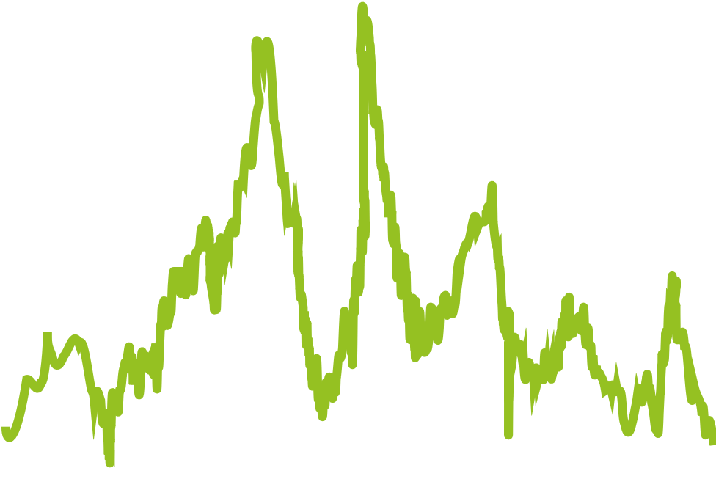

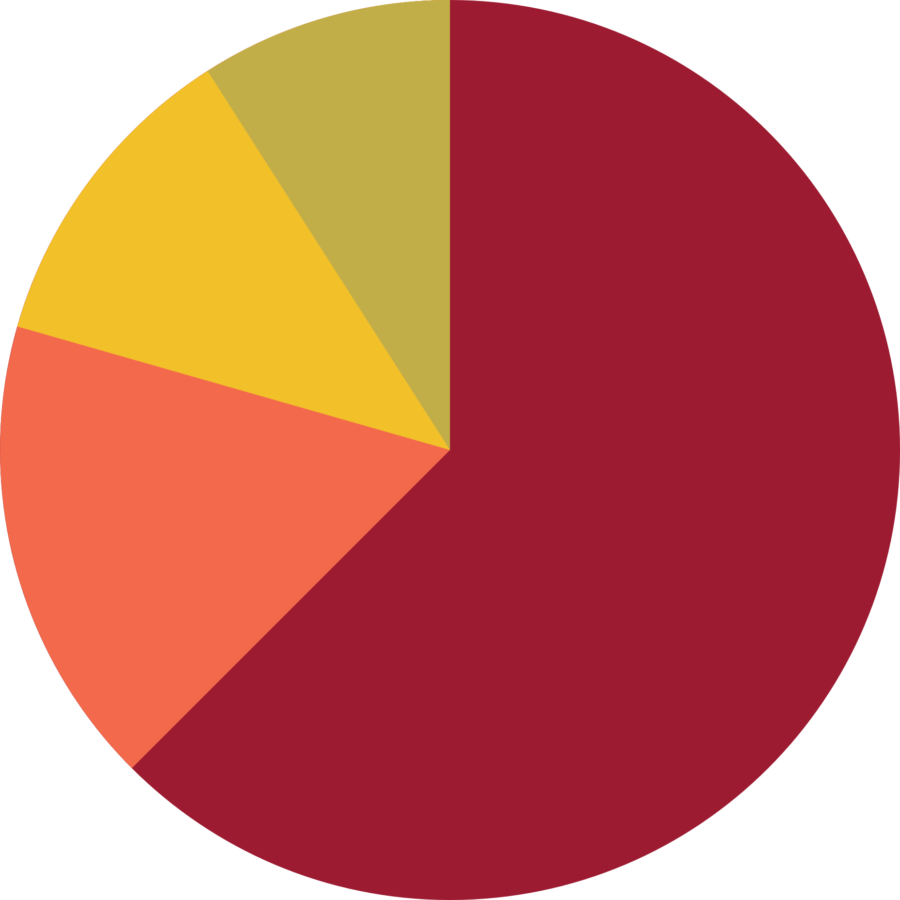


How is an Machine Learning AI developed?
Example: Anomaly Detection and Classification and the difference to Condition Monitoring
1. Training
2. Evaluation
Raw Data
Model
Model Evaluation
Optimized Model
The model is adjusted to data with a learning/training algorithm
Optimization of model quality by adjusting meta parameters
3. Anomaly Detection
4. Anomaly Localization
5. Anomaly Classification
Live Data
Model Output
Reaction Time
Membrane tear
in valve
Pressure
76 %
Bearing
damage
Cylinder
friction
Reaction Time
Analysis on Real Time Data
17 %
Notes:
Based on the data from the machines, an AI model is learned by using the Festo AX machine learning algorithms, which knows the normal operational state of the machines.
The model is optimally adapted to the customer's data by adjusting the model parameters in order to obtain the best possible prediction quality. The model calculates an anomaly score based on the machine data. A low anomaly score means that the machine is in the previously learned normal state.
After initial training, the model is applied to live data from the machines and begins to analyse it. If the model detects deviations from the learned normal operational state in these data streams, the anomaly score increases and a notification is sent to the user.
In the notification to the user, the learned model automatically calculates which input signals were decisive for the deviation from the learned normal state. This provides the user with an automated root cause analysis that helps to localise the source of the error.
In addition, it is possible to classify known anomaly patterns, i.e. to provide them with a diagnosis or recommendations for action. If an already known anomaly pattern is recognised by the model, the user is notified directly of the corresponding diagnosis or recommended action in addition to the localisation. Using the human-in-the-loop principle, further error patterns can be classified during operation, creating an extensive knowledge base and concretising the calculations of the models.

Slide 10
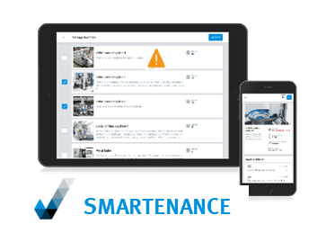
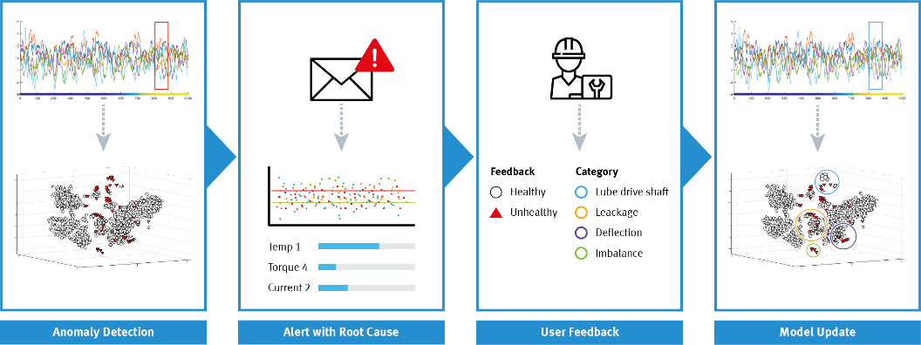
Festo AX Toolkit, Smartenance
“Human-in-the-loop”
Notes:
Machine Learning
Lernen von normaloperativen Verhaltensmustern:
Sammeln der Daten des normalen, gesunden Zustands der Maschine bzw. des Prozesses
Entweder greifen wir dazu auf bereits existierende historische Daten zu oder starten das Projekt damit, Daten zu sammeln
Das trainierte Modell wird hier mit Hilfe eines dreidimensionalen Koordinatensystems dargestellt
Die weißen Kreise repräsentieren das trainierte Modell des normaloperativen Zustands
Detektion von anormalen Verhaltensmustern:
Neue Daten, die ungesunde Verhaltensmuster aufweisen, kommen hinzu
Das bedeutet, diese Daten weichen vom vorher trainierten Modell ab
Diese Anomalien werden mit Hilfe der roten Dreiecke im Modell dargestellt
Auch die Korrelation der Parameter kann eine Anomalie auslösen, während sich die einzelnen Parameter weiterhin normal verhalten

Slide 11
Highlights of any Festo Data/AI Solution – incl. OEE and Cost Optimisation
The approach – Festo Digital Business is operating like an Engineering / Consulting Service Provider at daily rates
Independent from components/brands
Independent from machines
Independent from IT/OT-structures
Predictive
Maintenance
Predictive
Quality
Predictive
Energy
Predictive Optimization / OEE
11

Slide 12
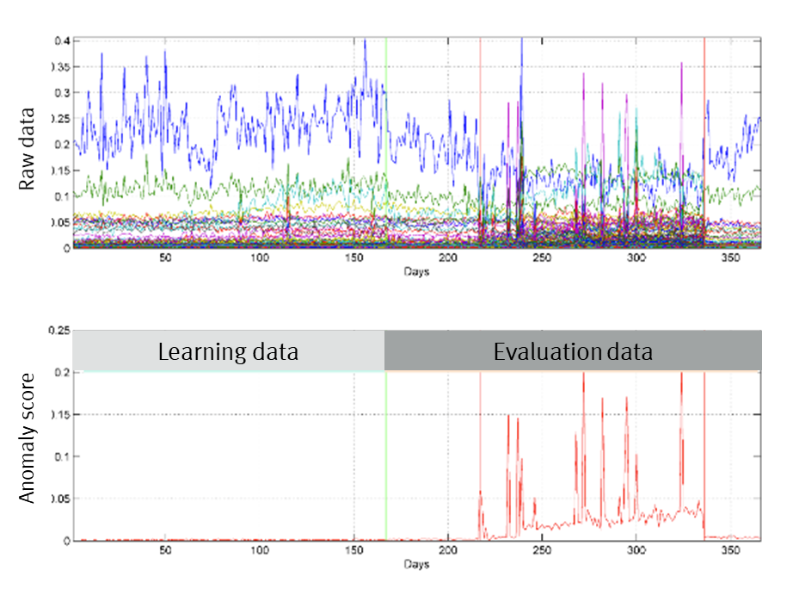

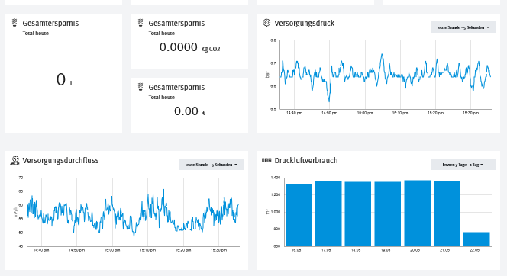
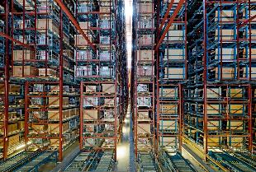

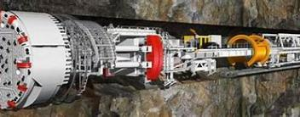
Industry 4.0, Digitalisation and AI-driven Customer Projects
  Maintenance for Motors/Frequency Converters, High Rack Warehouse
Compare existing data versus example with additional sensors
Prediction of motor/ frequency converter breakdowns, and others
Avoid unexpected downtime
Increase delivery reliability
  Building Automation – Energy Saving
Combine building data (energy, cooling, solar, etc.) with weather forecast
Overcome slow closed-loop-control, increase convenience, save energy
Multi-Step approach:
Data and IoT connectivity
AI improvements
  Tunnel drilling machine:
  Very expensive and unique equipment
  Expensive maintenance issues
  Historic tracking data was available
  Data modelling with machine learning
  Result: 80…130 days before breakdown
➔ AI Maintenance
➔ AI Energy
➔ AI Maintenance

Slide 13

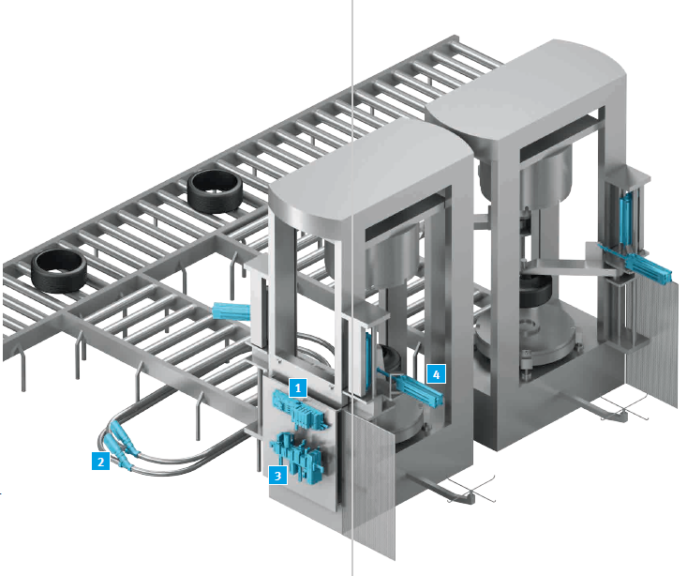
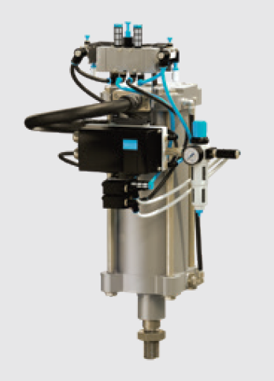
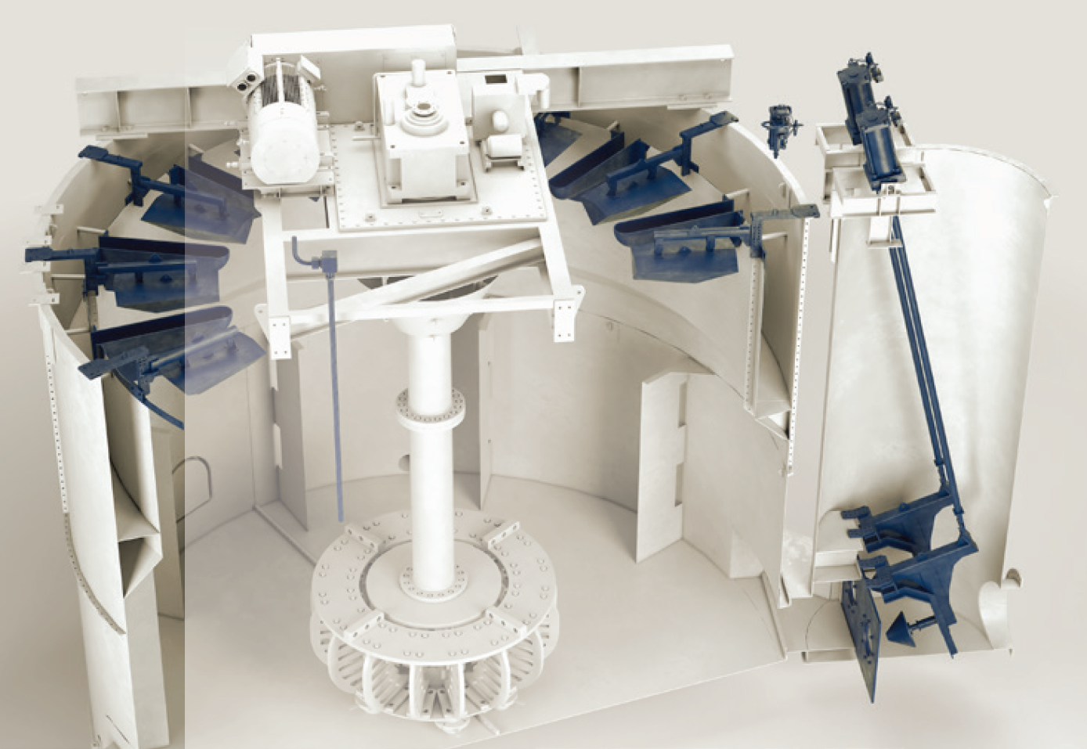
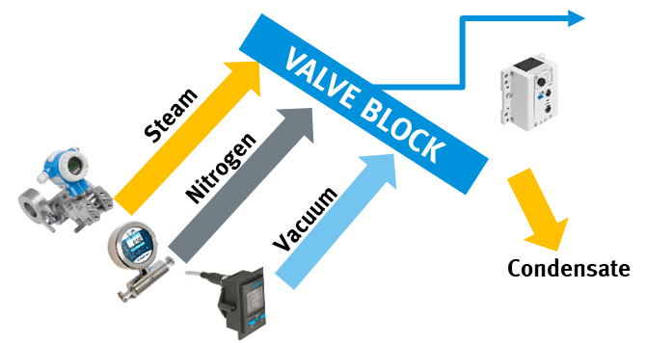
Industry 4.0, Digitalisation and AI-driven Customer Projects
  Performance and energy optimisation on
  curing press: Solution Concept +15%
Digital pneumatics with Festo Motion Terminal: closed-loop circuits, programmable ramps, data acquisition
Multi-Step approach:
VTEM: Data + hardware improvements
Data and IoT connectivity, e.g. energy
AI improvements
  Flotation Cells
  Dec. Automation CPX-CEC, MTP optional
  Integrated sensors increase quality and output >30%
  Substitution of positioners saves €/$
  Maintenance cylces reduced/planned
  Digitalisation and AI saves great money
  Clean Docks
  Dec. Automation CPX-CEC, MTP optional
  Autonomous and flexible stations can be pre-assembled and pre–tested.
  All data analysed on site / real time
  ➔ quality improvement ➔ OEE
  Maintenance cylces reduced/planned
  AI also monitors and predicts pipe transport of granulate
➔ AI Energy+OEE

Slide 14
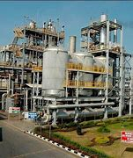

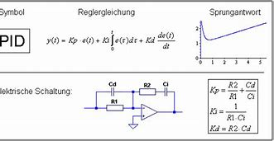
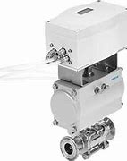
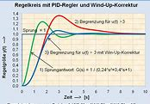

Details: AI Analytics and Optimisation on PID-controllers (PIMS = PI system of OSIsoft, “data lake”)
Classification and Anomaly Detection on PID controllers from many suppliers/plants
Customer challenge:
PIMS = Plant Information Management System contains PID controller data in 2-5 sec. sampling rates from all PID suppliers.
However, today the data lake is a “grave” without use e.g. good/bad/manual controller settings are not known or analysed.
Goal:
Assessment of data quality
Grouping into good/bad and conspicuous controllers ("manual")
Optimization of maintenance, engineering and process quality
Project status:
Data structure checked, data for ~8 months analysed
Use Festo AX (Predictive Quality) for defined patterns and classification of control settings. Project to be continued.
New algorithms developed (patterns + weighted criteria over time)
Notes:
Plant Information Management System (PIMS)
Zur Navigation springenZur Suche springenEin Plant Information Management System (PIMS) sammelt und integriert Informationen über einen Produktionsprozess aus verschiedenen Quellen. Da in der Vergangenheit Prozessleitsystemen die Speicherkapazität für die sehr große Datenmengen bei der Langzeitarchivierung fehlte, werden Daten zur Archivierung von historischen Prozessadaten traditionell in separaten Systemen (PIMS, Historian) von Drittanbietern abgelegt. Die Anbindung zum Prozessleitsystem erfolgt zum Beispiel über OPC. Die Daten werden übergeordneten System (ERP, MES) zur Verfügung gestellt oder über Arbeitsplatzrechner abgerufen und ausgewertet.^{[1]}
Wichtige Aufgaben eines PIMS sind:
Unternehmensweit Daten sammeln, konsolidieren und bearbeiten
Analyse von Produktionsleistung, Produktqualität, Prozesskapazität und Regelkonformität.
Bereitstellung von Key Performance Indicator (KPI) zur Verbesserung der Entscheidungsprozesse
Reporting zur Entscheidungsunterstützung und Dokumentation
Konsolidierung von Daten aus verschiedenen Quellen (Enterprise Resource Planning (ERP), Labor, Prozessleitsystem…)
Integration von off-line Daten (Labor, Berechnungen, zukünftige Lastprofile)
Zugriff über das unternehmensweite Intranet auch von Büros aus. Via Web (Thin client) oder Tcp/Ip (Thick client)
Anreichern/Veredeln von Rohdaten
Ereignisgesteuerte Berechnungen
Langzeitarchivierung von Daten und Meldungen (über viele Jahre)
Reporting
Hersteller sind:
AspenTech InfoPlus.21 (IP.21)
Osisoft PI
Honeywell PHD
Wonderware Historian
GeFanuc iHistorian
Folgende Unterteilung gibt es:
SQL / Desktop – Systeme
SCADA – Historian
Enterprise Historian

Slide 15
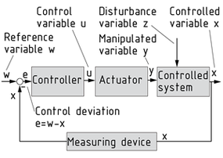
Project Start and Scope
Scope of pilot application:
~750 PID controllers for different tasks, various manufacturers, control systems, several locations
Batch production
Pilot project:
Data for offline analysis Jan.-Sept. 2021.
3GB. Transfer via Excel lists.
Sampling rate 2-5 sec. for W, X, Y as "condensed data from SPIMS" (without scaling and reference to the application)
Option:
Online data connection or on-prem installation of AI algorithms, once the project is continued.
For this, a new algorithm had to be developed

Slide 16
First Results / Overview
Quantil | 0% | 25% | 50% | 75% | 100%
Setpoint changes | 0 | 0 | 56 | 1736 | 6766378
Details:
25% of PID controllers had no
change in set point at all during
~8 Months (no job?)
50% of PID controllers moved in
~8 Months 56-times only
Upper extrem: PID with more than
6 Mio. changes ➔ Wear?
➔ stable process? ➔ Good?

Slide 17
Secific Findings: Behaviour of PIDs that did not change set-pints at all
What is the feedback of your experts: good? bad? conspicious? And which is the biggest painpoint?

Slide 18
Secific Findings: Behaviour of PIDs that have changes in set-pints
What is the feedback of your experts: good? bad? conspicious?

Slide 19
Discussion Points: Which settings are „good“ and „bad“ in your specific installation?
Batch mode settings could be very different in their evaluation than in continous processes

Slide 20
Discussion Points: Which Feedback and Details are needed by customers‘ experts?
Plant / PID identifyer and basic use „Manual“ AI-score „god/bad“ and details of „problems“

Slide 21

Summary - Customer Feedback so far:
Great to see, that PIMS data contains valueable information:
PID controller data from PIMS data lake is sufficient for AI anaytics. Results:
Maintenance optimisation:
Detect e.g. the worst PIDs „of the month“, learn from the best.
Process/Engineering optimisation:
Detect poorly engineered processes
Cost could be analysed (wrongly selected PID where not needed at all)
Manual settings:
Detect managerial / operational deficits. Operational troubles become visible when PIDs in manual mode.
But also: Some problems could be verified, as we use many batch processes – and will be taken out of AI analysis per batch.

Slide 22
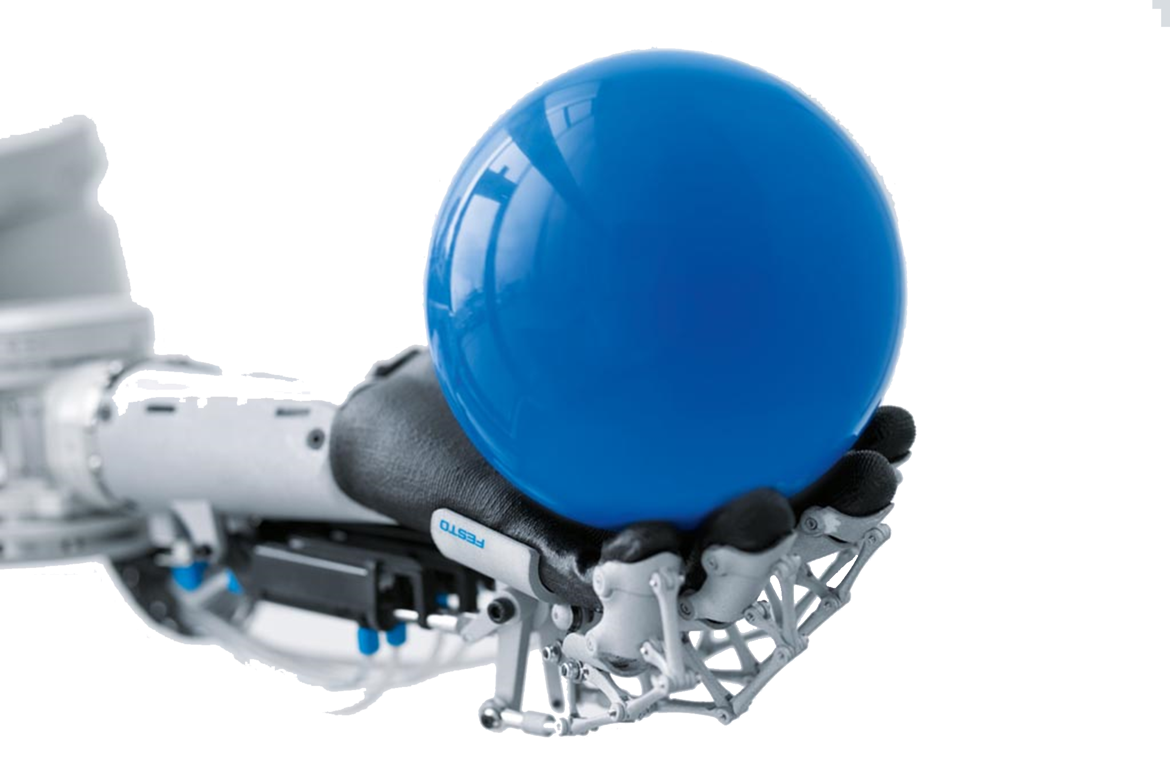
Thank you for your attention
Questions?

Slide 23
Thank you

Slide 24
Technical Appendix on Algorithms

Slide 25







Overview - Festo AX Architecture
Festo AX Solutions
Predictive quality
Predictive energy
Predictive maintenance
Dashboards
APIs
Notifications
C l o u d
Festo AX Brain
AI Training Engine
Rule Engine
Model Management
Data Storage
Festo AX Field
AI Scoring Engine
Streaming Analytics
Event API
E d g e
MQTT
OPC UA
CI
ENGP
Thick Edge
Thin Edge
Festo AX Connectivity
S7
Modbus
FINS
…
O n p r e m
Notes:
The different layers of Festo AX (we start at the bottom):
0. Every device that sends data, can be connected to Festo AX. This can be simple components/sensors/actuators, machines up to whole production lines and plants.
Festo AX Connectivity: To handle state of the art IoT protocols as well as legacy automation protocols, Festo AX offers an integrated connectivity layer to support a broad range of different industrial protocols. This interface library growth continuously and in case a specific protocol is missing, we try to find a solution for the customer by adding this interface to the Festo AX connectivity layer
Festo AX Field: The Field is an intelligent layer, which uses the trained models and to analyze real time data that is streamed from the machines. The Field can be installed close to a machine to keep the latency small and to process high frequent data. It also contains an Event API, so that anomaly events can be sent to 3rd party systems like HMIs, Dashboards, etc.
Festo AX Brain: The Festo AX Brain is the central component that is used for configuration of data interfaces, model training and management and storage of the streamed data. Therefore, the user can use an integrated web-based interfaces, that he can also use to create dashboards for the visualization of results from the AI Scoring Engine and the Streaming Analytics service as well as different data aggregations. One instance of a Festo AX Brain can handle multiple Festo AX Fields. The Festo AX Brain also offers APIs for integration in already existing system architectures at customers.
Festo AX Solutions: Based on the modules from the previously mentioned layers, we tailor best-fitting solutions for our customers in the fields of predictive quality, predictive energy and predictive maintenance. As we use Docker for the installation of the different layers, we are flexible in the installation environment: The whole solution can be installed on an Edge Device, on Premises or in Cloud systems of different vendors. Furthermore, a distributed and scaling installation of the different layers is possible.

Slide 26






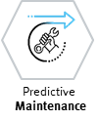
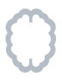


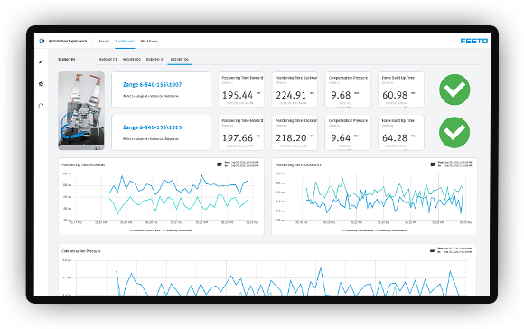




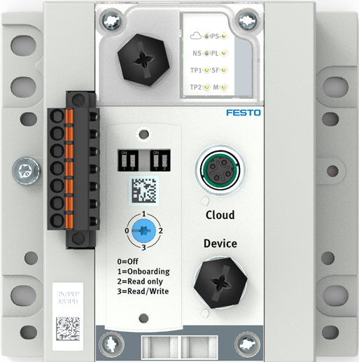


Details - Festo AX Architecture
Customer Systems
DB
Data Lake
ERP
MES
. . .
Data Transfer
Festo AX Connectivity
Festo AX Field (1..n)
Festo AX Brain
AI/Machine Learning Engine
Model Training
OPC-UA
HTTP
Model Evaluation
Smartenance
Anomaly Detection
Festo Prot.
MQTT
Monitoring
Anomaly Localisation
S7 Prot
FINS
Anomaly Detection
Classification
A P I
Mod
bus
. . .
Analytics
Monitoring
Workflows
Visualization
Festo AX Field (1..n)
3rd Party
Visualization
Analytics
Maintenance Management
…
…
Persistence
Monitoring
Thick Edge
Thin Edge
Anomaly Detection
C L O U D
E D G E
O N P R E M

Slide 27
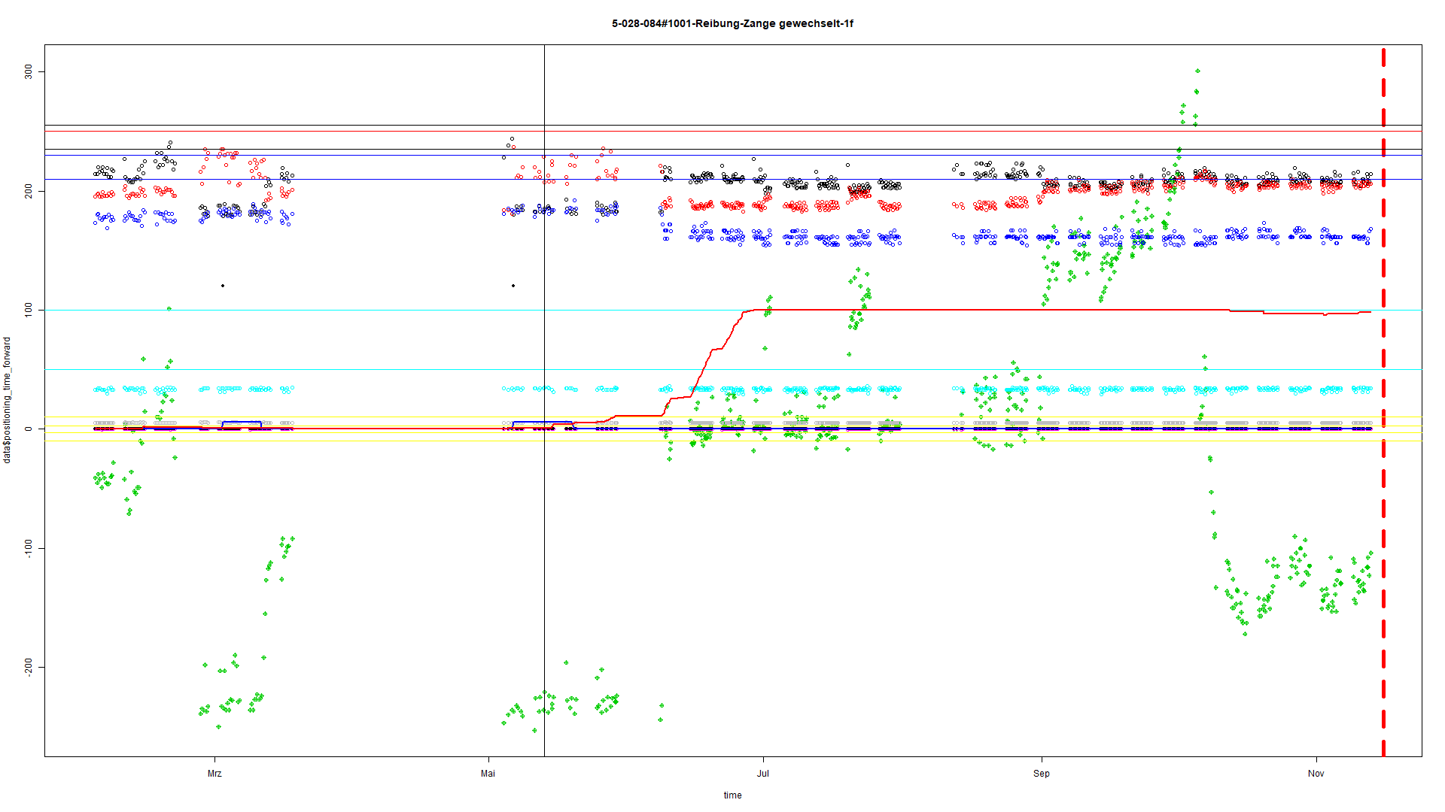
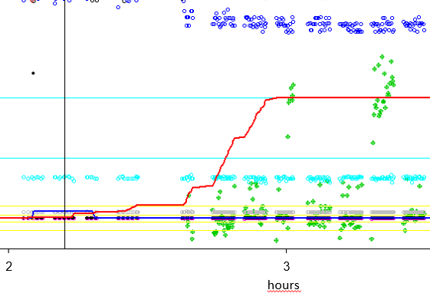
Festo AX: Superior Technology - Artificial Intelligence versus Condition Monitoring
Automotive Industry, several thousand welding gun applications online, perfectly optimized predicitve maintenance
1
0,6
AI Algorithmus: Anomaliescore increased, notification is sent
Anomaly score
0,3
Condition Monitoring System: no signals
0
1
2
3
4
5
hours
Notes:
Historische Daten von 365 Tagen wurden aufgezeichnet und zur Verfügung gestellt
Lerndaten von Tag 1 – 160
Stillstand des Minenbohrers anTag 340
Die erste Anomalie wurde an Tag 210 detektiert
Der kontinuierliche Anstieg des Anomaliescores ist charakteristisch für den Verschleißprozess
Ergebnis: die erste Anomalie hätte 130 Tage vor dem Stillstand erkannt werden können

Slide 28
Festo AX
AI vs. Condition Monitoring
KI Algorithmus: Anomaliescore increased, notification is sent
➔ 2-3h before breakdown !
Condition Monitoring System: no signals
Notes:
Historische Daten von 365 Tagen wurden aufgezeichnet und zur Verfügung gestellt
Lerndaten von Tag 1 – 160
Stillstand des Minenbohrers anTag 340
Die erste Anomalie wurde an Tag 210 detektiert
Der kontinuierliche Anstieg des Anomaliescores ist charakteristisch für den Verschleißprozess
Ergebnis: die erste Anomalie hätte 130 Tage vor dem Stillstand erkannt werden können

Slide 29
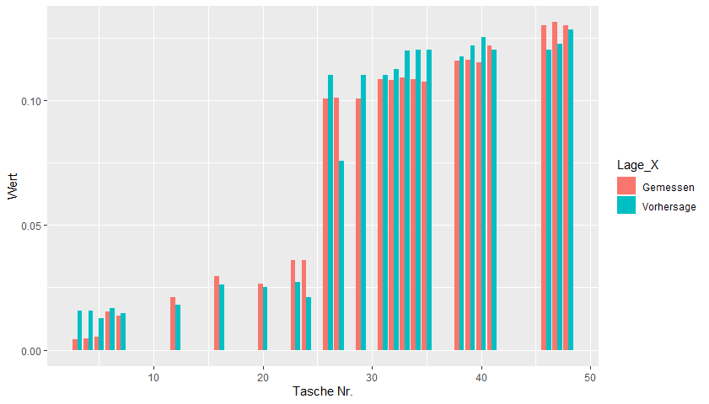
Festo AX
Predictive Quality: See quality losses in tooling machines in advance from data (research done at a complete machining centre)
Notes:
Historische Daten von 365 Tagen wurden aufgezeichnet und zur Verfügung gestellt
Lerndaten von Tag 1 – 160
Stillstand des Minenbohrers anTag 340
Die erste Anomalie wurde an Tag 210 detektiert
Der kontinuierliche Anstieg des Anomaliescores ist charakteristisch für den Verschleißprozess
Ergebnis: die erste Anomalie hätte 130 Tage vor dem Stillstand erkannt werden können

Slide 30


Artificial intelligence application example in Process Industry with PIMS
(Plant Information Management System)
Process Symposium Istanbul
Presentation: 17th May 2022
Dipl.Ing. Eberhard Klotz, MBA
Global Sales Director Industry 4.0 and Digitalisation
Festo SE & Co KG, Germany
E-Mail: Eberhard.Klotz@Festo.com

