Slide 1

İşletmelerde Toz Tehlike Analizleri (TTA) ve Risk Azaltıcı Önlemler
Emre Ergun, IEP Technologies Türkiye GM
emre.ergun@hoerbiger.com, M: 0533-457-4412
18/05/2022

Slide 2
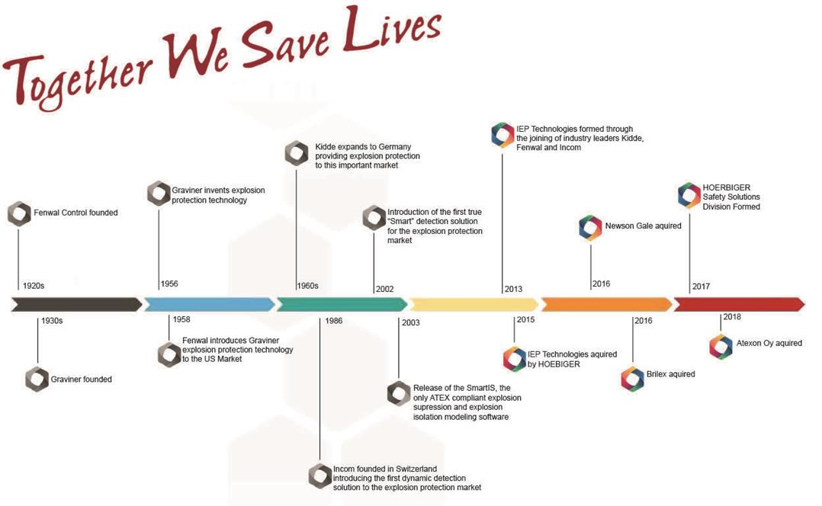
IEP Technologies Hakkında
IEP Türkiye Ofisi Kuruluşu, 2015 sonu

Slide 3
IEP Technologies Hakkında
IEP Technologies Türkiye: Merkez İzmir, Depo İstanbul
  Türkiye’de ofisi olan tek patlama korunma sistemi üreticisi
  Patlama korunma ve engelleme sistemleri sistem tasarımları
  Sistem seçimleri ve ihtiyaç analizleri
  Kurulumlarda sistem kontrolleri ve devreye alım
  Periyodik sistem bakımları, acil müdehale, olay sonrası analizler
  Patlama Korunma ve Engelleme Sistemleri Eğitimleri
  IEP Technologies Global garantisi altında hizmet

Slide 4
Toz Patlar mı ?
Bizde toz patlaması olmaz...
Bizim malzememiz patlayıcı değil ...
Bizim ekipmanda yüksek basınç yok...
Bizde bugüne kadar hiçbir olay yaşanmadı...

Slide 5
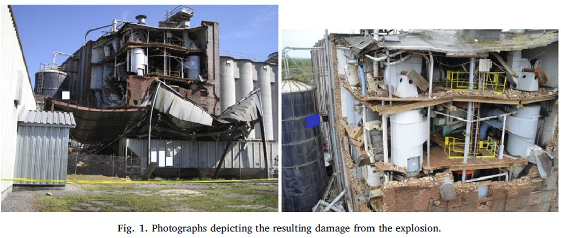
Bizde Patlama Olmaz – Yem/Tahıl
Ref - Journal of Loss Prevention in the Process Industries 62 (2019) 103928

Slide 6
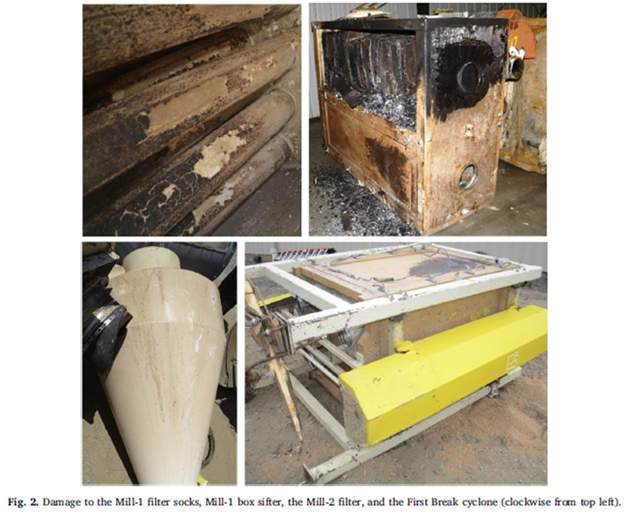
Bizde Patlama Olmaz- Yem/Tahıl
Alevlenme değirmende başlar
Değirmen filtresi içinde toz patlaması yaratır (ZONE20 ortam)
Patlama bağlantılı boru hatlarından diğer ekipmanlara yayılır
Ekipmanlarda oluşan hasarla, bina içine üretim alanlarına dağılır (ZONE22)
İkincil patlamalar bina içinde devam eder...
Ta ki yakıt bitene kadar...

Slide 7
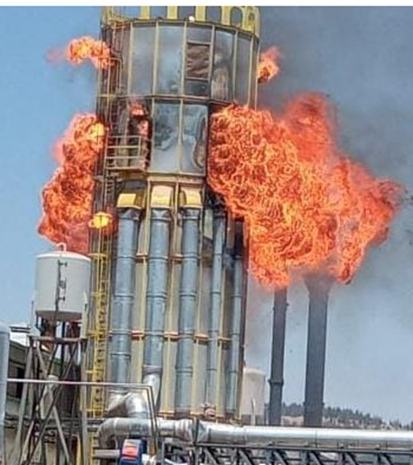
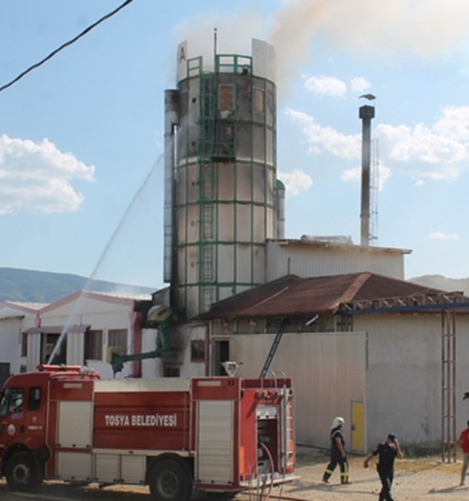
Bizde toz patlaması olmaz.../Ahşap

Slide 8
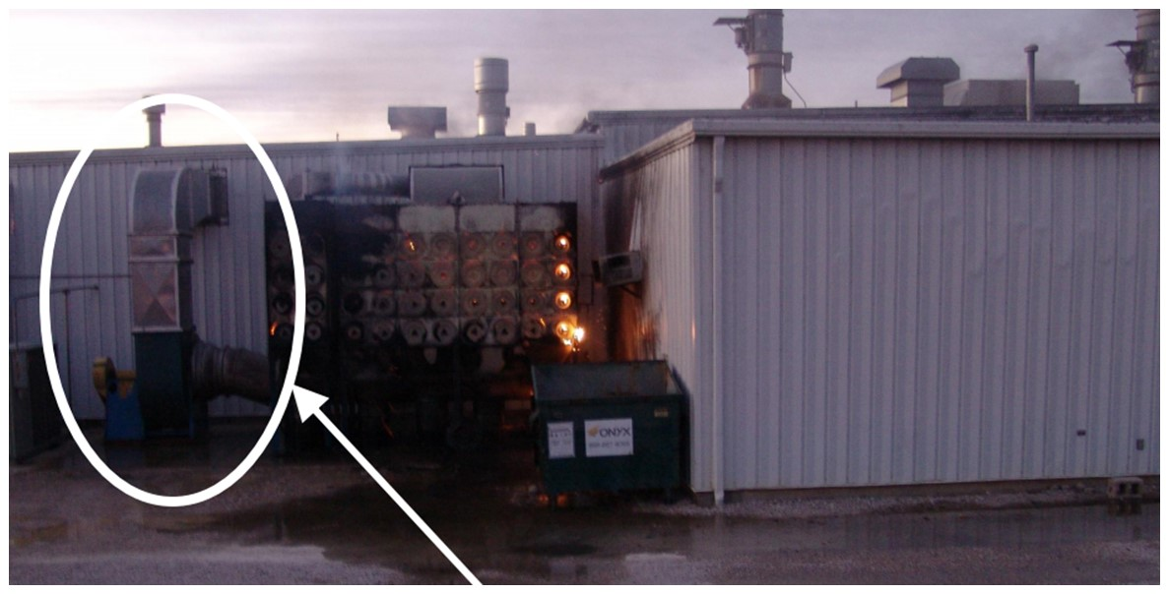
Bizde toz patlaması olmaz.../Kağıt
Filtre de patlama ve devamında yangın...
Ref- ABD Kağıt Fabrikası Yangın ve Patlaması

Slide 9
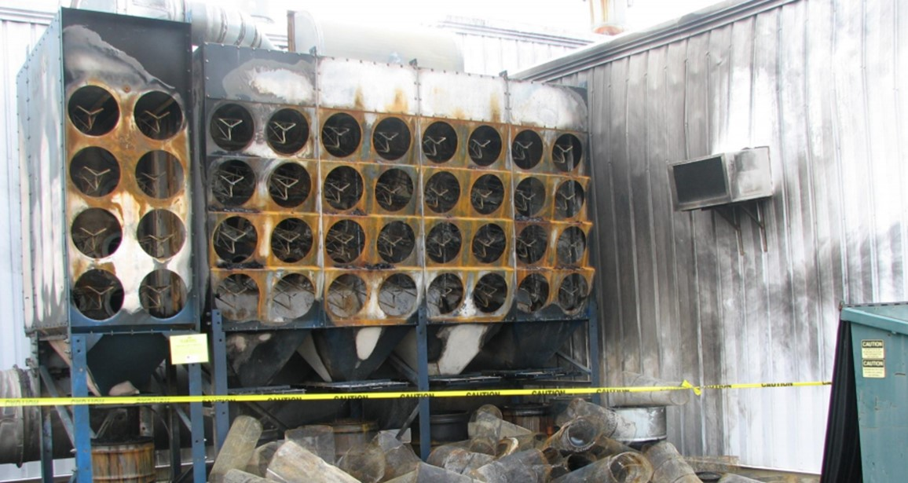
Bizde toz patlaması olmaz.../Kağıt

Slide 10
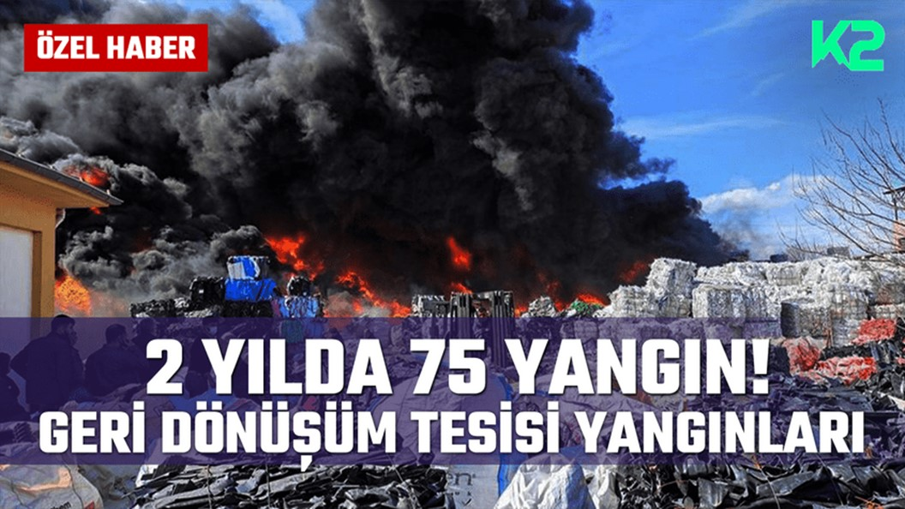
Bizde Patlama Olmas.../Geri Dönüşüm

Slide 11
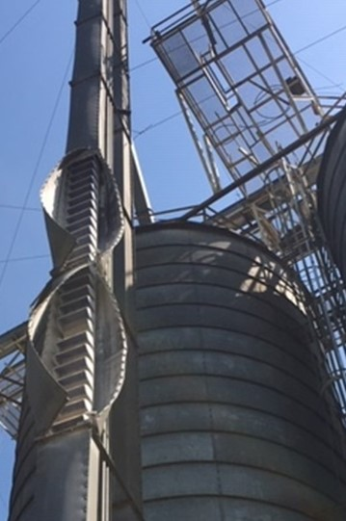
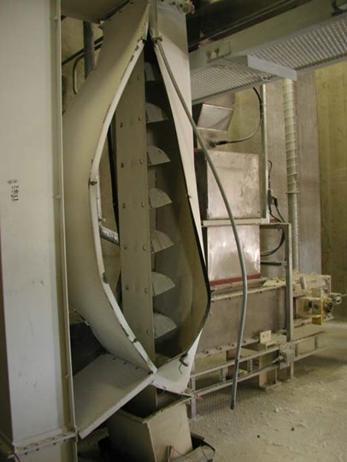
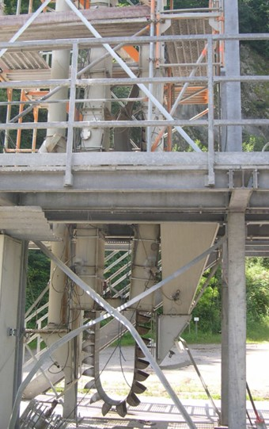
Kovalı Elevatör Patlaması

Slide 12
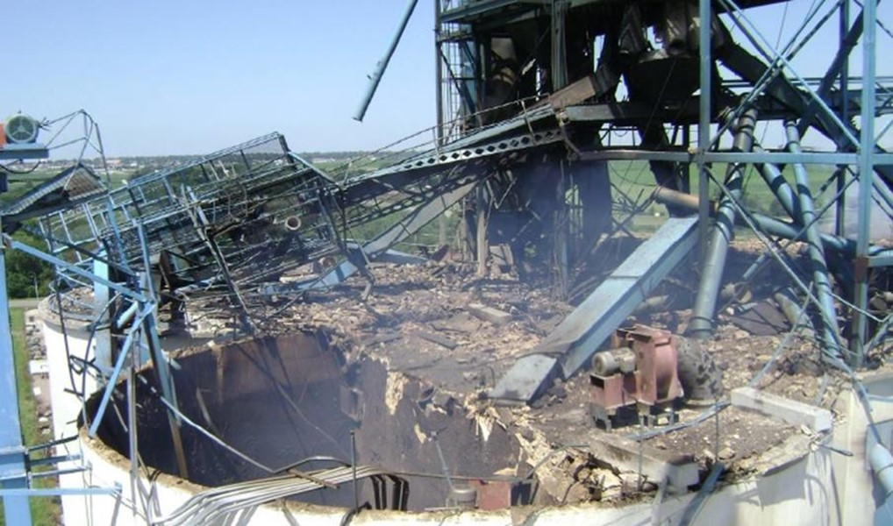
Tahıl Deposu Patlaması

Slide 13
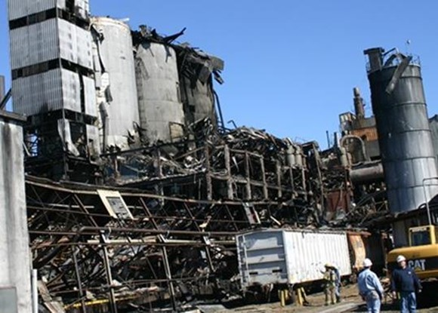
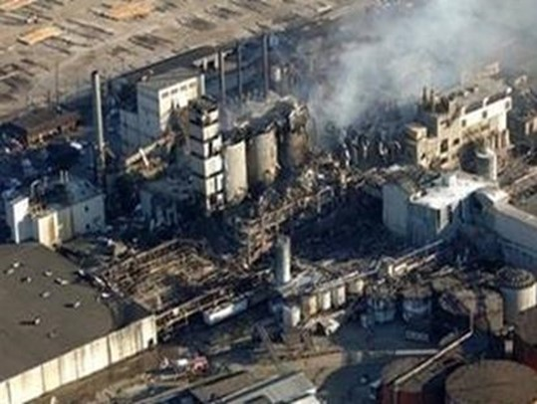
Şeker FabrikasıPatlaması

Slide 14
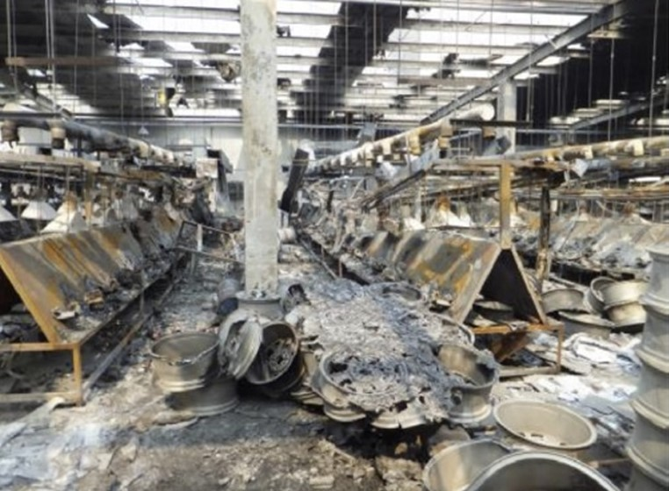
Metal - Jant Fabrikası Metal Tozu Patlaması

Slide 15
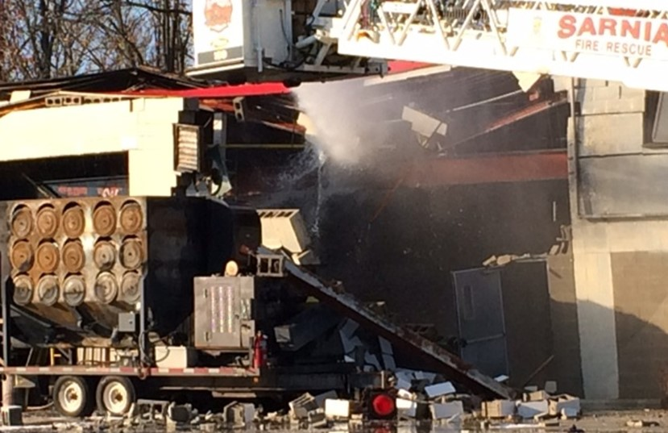
Boya Sektörü – Filtre Patlaması

Slide 16
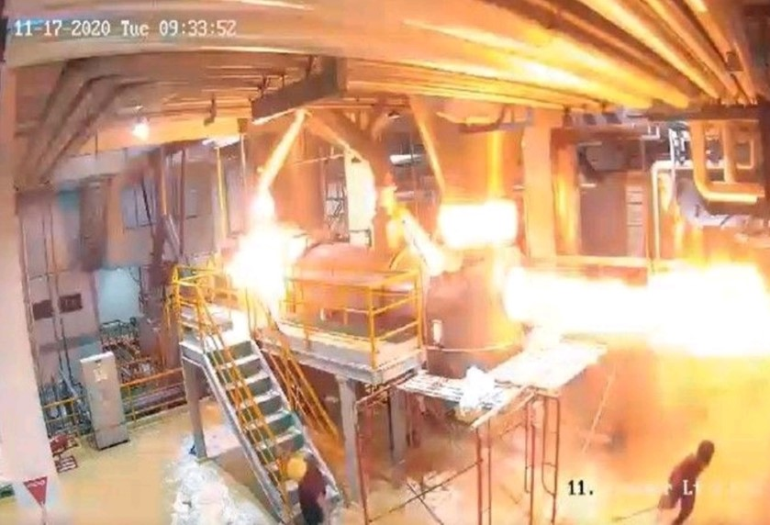
Gıda– Süt Tozu Üretimi Kurutma Sistemi Patlaması

Slide 17
Toz Tehlike Analizleri
Kapsam- fabrikanın hangi bölgeleri ?
TTA Takımı oluşturulması
Proses bilgileri ve işlenen Toz Malzemelerin Alevlenme Özelliklerinin belirlenmesi !!!!
Saha ziyareti ve incelemeler
İncelenen ekipmanlar ve ortamlarda toz parçacık dağılımları belirlenmesi
Ortamda toz birikimleri incelenmesi
EX ZONE kontrolleri (ekipmanlar, çalışma alanları)
Alev kaynakları analizi EN1127-1, alevlenme olasılığı belirlenmesi
Ekipmanlar arası bağlantıların incelenmesi – olası patlama/yangın yayılımları
Geçmiş kaza ve ramak kalaların incelenmesi
Şu anda kullanılan risk kontrolleri ve yeterlilikleri (NFPA68, 69, 654, VDI, BSI)
GAP Analizi
  Kalan riskin yüksek olduğu bölge/ekipmanların belirlenmesi
  Yeni/ek patlama korunma/engelleme sistemleri seçilmesi, hesaplanması
  Öneriler ve uygulama
Tekrar. Periyodik olarak raporların incelenmesi ve olası proses/malzeme değişimlerinin risklere etkisinin belirlendikten sonra güncellemelerin yapılması
Ref – NFPA652
Notes:
Explosion protection addresses both the vessel and the interconnection to other plant items:
Starting with vessel protection, there are three main means. First we have containment whereby the plant is made very strong such that it can withstand the maximum pressure generated by an unmitigated explosion event ~10 bar. This is an expensive option and in the case of large vessels is not pratical.
Explosion suppression, where the majority of our business lies, relies on early detection of an explosion and then the rapid deployment of suppressant, such that the explosion pressure is reduced below the strength of the plant.
Finally we have explosion venting, which is effectively a weak panel in the vessel which yields at low pressure allowing the release of product and flame. The photo shows efficacious deployment of venting to protect a bag filter, but as you can see results in a very large fireball being ejected from the vessel. This fireball obviously causes a risk to personnel and the possibility of post explosion fires and consequent explosion occurrences in other plant.
The solution here in the case for venting and suppression determines the hardware count and the reduced explosion pressure, Pred.
These techniques are well understood and have been deployed in the field for over 30 years.

Slide 18
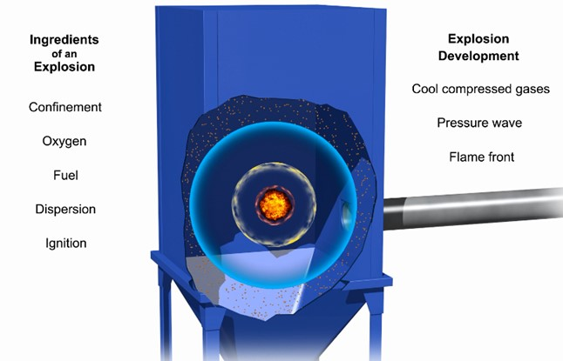
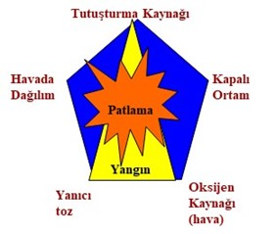
Toz Patlamaları – Nasıl Oluşur?
Toz veya gaz halindeki yakıtın kıvılcım ile alevlenmesi ve hızlıca yanması ile başlar
Ani ve yüksek miktarda gaz açığa çıkar (yanma tepkimesi)
İç basıncın artışından kaynaklanarak parçalanan konteynerden çıkan ani gaz ve alev topu patlama olarak adlandırılır

Slide 19
PATLAMA RİSKİ TAHMİNİ
Risk = Pzon * CPign * DPmax
R: Patlama riski
P : Tehlikeli durum faktörü (hazard factor), patlayıcı ortam oluşma olasılığı (EX ZONE)
C : tehlikeli durumun zarar oluşturma olasılığı: EN1127-1
(ALEV KAYNAĞI BULUNMA OLASILIĞI VE SÜRESİ)
D : zarar faktörü, zararın büyüklüğünün tahmini
(PATLAMA ŞİDDETİ, Kst, Kg gibi değerler)
Notes:
Explosion protection addresses both the vessel and the interconnection to other plant items:
Starting with vessel protection, there are three main means. First we have containment whereby the plant is made very strong such that it can withstand the maximum pressure generated by an unmitigated explosion event ~10 bar. This is an expensive option and in the case of large vessels is not pratical.
Explosion suppression, where the majority of our business lies, relies on early detection of an explosion and then the rapid deployment of suppressant, such that the explosion pressure is reduced below the strength of the plant.
Finally we have explosion venting, which is effectively a weak panel in the vessel which yields at low pressure allowing the release of product and flame. The photo shows efficacious deployment of venting to protect a bag filter, but as you can see results in a very large fireball being ejected from the vessel. This fireball obviously causes a risk to personnel and the possibility of post explosion fires and consequent explosion occurrences in other plant.
The solution here in the case for venting and suppression determines the hardware count and the reduced explosion pressure, Pred.
These techniques are well understood and have been deployed in the field for over 30 years.

Slide 20
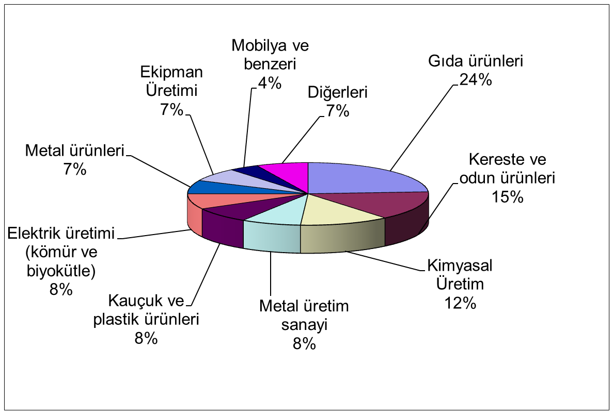
Riskli Endüstriler ve Maddeler
REF – USA OSHA

Slide 21
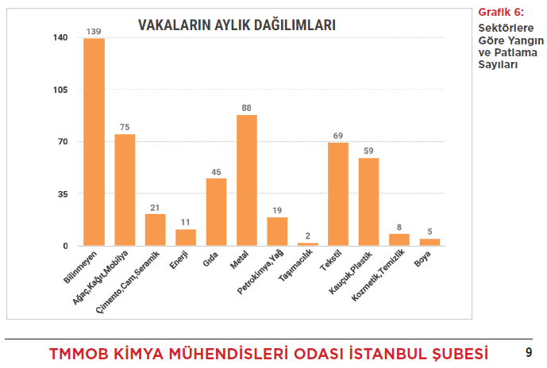
Riskli Endüstriler ve Maddeler

Slide 22
Riskli Ekipmanlar
Bölgeler | ABD (1985 – 1995) |  | İngiltere (1979 – 1988) |  | Almanya (1965 – 1980)
 | Olay Sayısı | % | Olay Sayısı | % | Olay Sayısı | %
Toz Toplayıcılar | 156 | 42 | 55 | 18 | 73 | 17
Değirmenler | 35 | 9 | 51 | 17 | 56 | 13
Taşıma sistemleri | 32 | 9 | 33 | 11 | 43 | 10
Silo/Bunkerler | 27 | 7 | 19 | 6 | 86 | 13
Kurutma / Kazan Sistemleri | 22 | 6 | 43 | 14 | 34 | 8
Karıştırıcılar | >12 | >3 | 7 | 2 | 20 | 5
Diğerleri / Bilinmiyor | 84 | 23 | 95 | 31 | 114 | 27
Toplam | 372 | 100 | 303 | 100 | 426 | 100
REF: Guidelines for Safe Handling of Powders and Bulk Solids, CCPS, AICHE

Slide 23
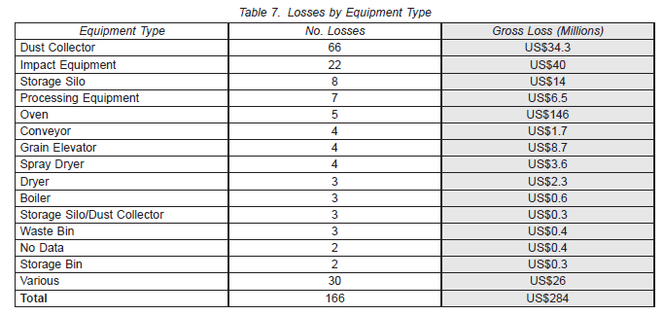
Sigorta İstatistikleri- Ekipman Hasarları
REF- FM Global 1983-2006

Slide 24
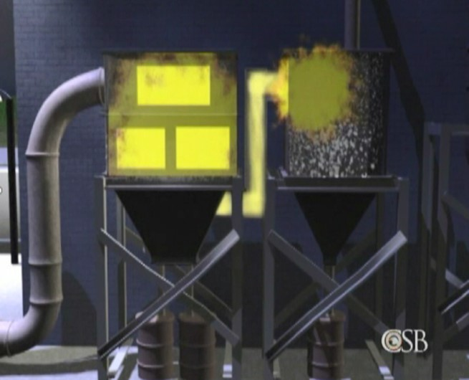
İkincil Patlamalar: Kontrolsüz Risk
İkincil patlamalar, ana patlamanın alev ve basıncının bağlantılı ekipmanlara ve ortama yayılması ile oluşur (borular, şutlar, konveyörler, …vs )
Yetersiz fabrika temizliği
Ortamda toz birikimi ~1mm +
Ref – US Chemical Safety Board,

Slide 25
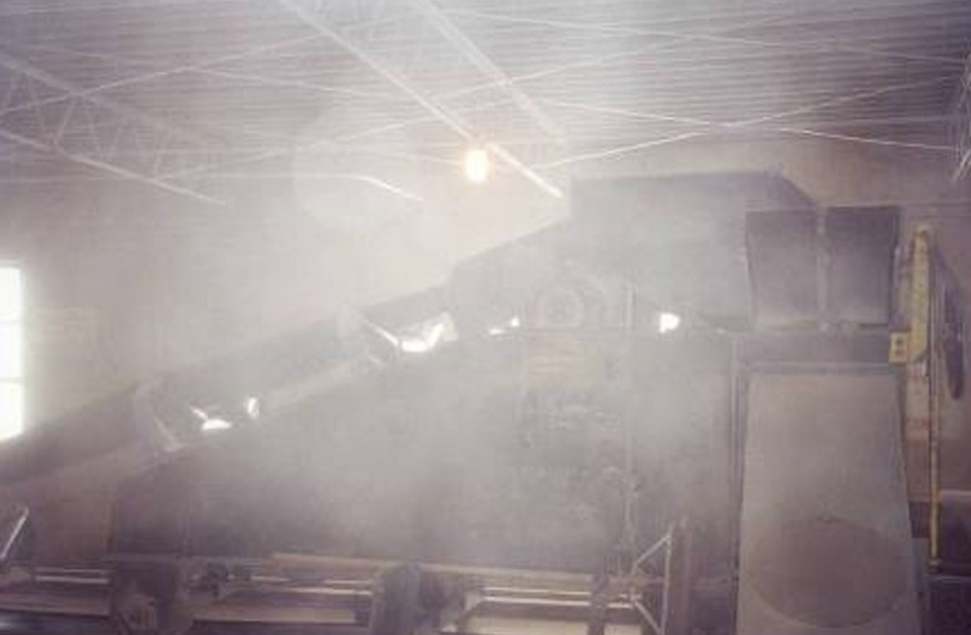
Ortama Toz Kaçakları
Aşırı miktarda havada askıda yanıcı toz !!!

Slide 26
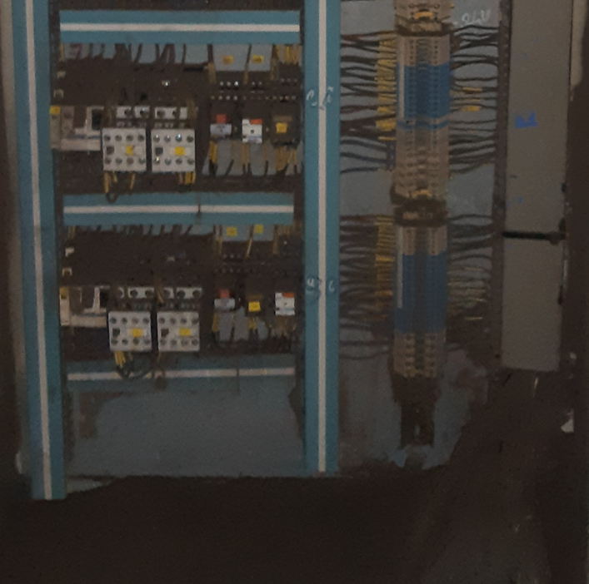
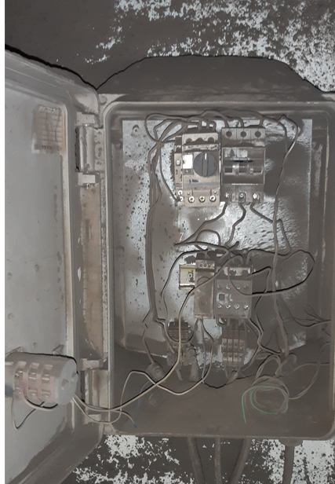
Ortamda Toz Birilimi: İkincil Patlamalar

Slide 27
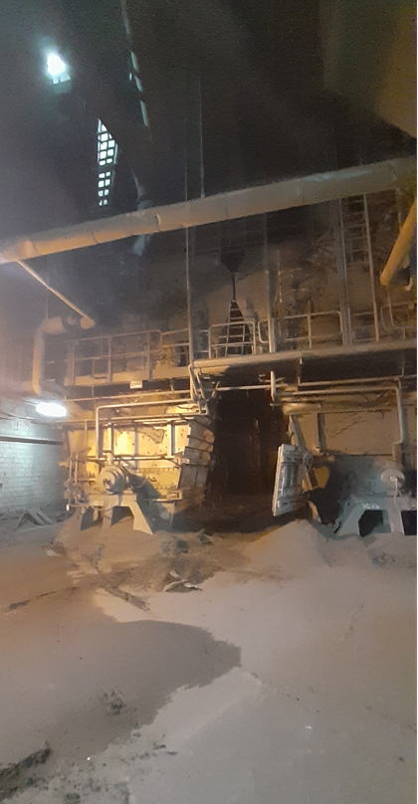
Ortamda Toz Birilimi: İkincil Patlamalar
Enerji Santrali Kömür değirmeni alanı:
Yerde 5-15cm arası toz birikimi (sınır 3mm!!!)
Değirmende olası bir patlamanın sonuçları ?

Slide 28
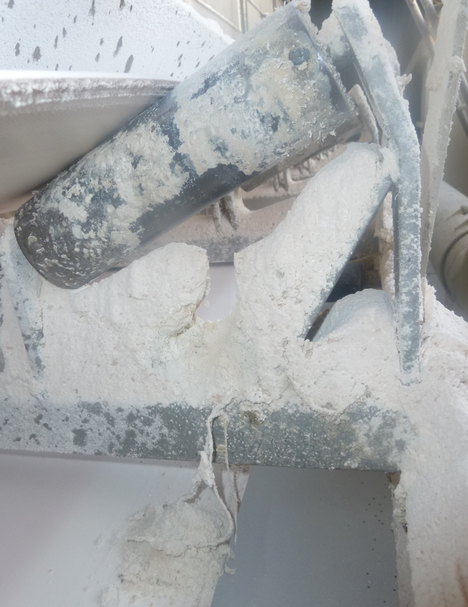
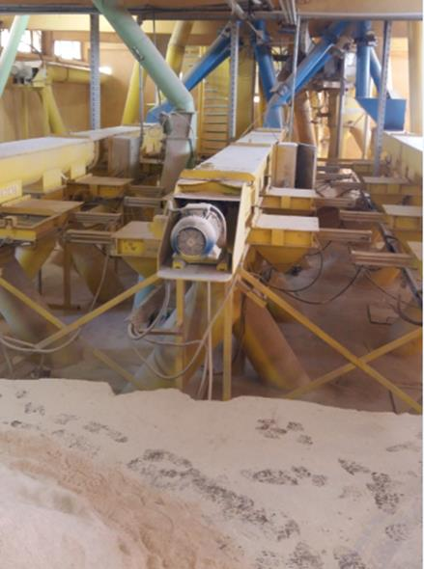
Ortamda Toz Birilimi: İkincil Patlamalar

Slide 29
Tehlikeli Bölge / ZONE Sınıfları (TOZ)
NFPA 654 Metodu
Biriken Tozun Derinliği (mm) | Birikim Sıklığı | Temizlik Prosedürü | Tehlikeli Alan Sınıfı (Zone)
Yüzey renginde değişiklik belirli değil | Yok | Yok | Sınıflandırma dışı (genel amaçlı alan)
<0.8 | Az sıklıkta. < Senede 3 defa | Oluştuğu vardiya sırasında | Sınıflandırma dışı (genel amaçlı alan)
<0.8 | Devamlı veya sık > senede 3 defa ve toz birikim 24 saat içinde | Avaraj toz birikimi 0.4mm nin altında kalacak şekilde düzenli temizlik | Sınıflandırma dışı ancak dust-tight(IP 6x, NEMA 4)
0.8 - 3mm | Az sıklıkta. < Senede 3 defa | Oluştuğu vardiya sırasında | Sınıflandırma dışı ancak toz-korunaklı kutu (IP 6x, NEMA 4)
0.8 - 3mm | Devamlı veya sık > senede 3 defa ve toz birikim 24 saat içinde | Avaraj toz birikimi 1.5 mm nin altında kalacak şekilde düzenli temizlik | Class II Div 2, ZONE 22
>3 mm | Az sıklıkta. < Senede 3 defa | Oluştuğu anda sistemi durdurup temizlik yapılması | Class II Div 2, ZONE 22
>3 mm | Devamlı veya sık > senede 3 defa ve toz birikim 24 saat içinde | Düzenli temizlikle toz birikimini minimize et | Class II Div 1, ZONE 21
Notes:
Explosion protection addresses both the vessel and the interconnection to other plant items:
Starting with vessel protection, there are three main means. First we have containment whereby the plant is made very strong such that it can withstand the maximum pressure generated by an unmitigated explosion event ~10 bar. This is an expensive option and in the case of large vessels is not pratical.
Explosion suppression, where the majority of our business lies, relies on early detection of an explosion and then the rapid deployment of suppressant, such that the explosion pressure is reduced below the strength of the plant.
Finally we have explosion venting, which is effectively a weak panel in the vessel which yields at low pressure allowing the release of product and flame. The photo shows efficacious deployment of venting to protect a bag filter, but as you can see results in a very large fireball being ejected from the vessel. This fireball obviously causes a risk to personnel and the possibility of post explosion fires and consequent explosion occurrences in other plant.
The solution here in the case for venting and suppression determines the hardware count and the reduced explosion pressure, Pred.
These techniques are well understood and have been deployed in the field for over 30 years.

Slide 30
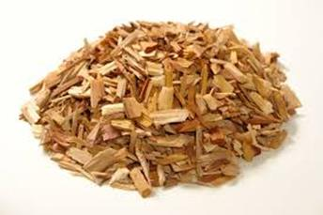



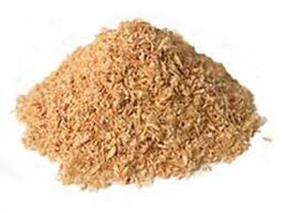

Hangi Toz Daha Kolay Alevlenir?
500 Micron Altı Parçacık Büyüklüğü ?
Parçacık büyüklüğü dağılımı ?
Rutubet Oranı ?
Kimyasal bileşenleri? (hibrid durum var mı?)
MIE, AIT ???
Notes:
Explosion protection addresses both the vessel and the interconnection to other plant items:
Starting with vessel protection, there are three main means. First we have containment whereby the plant is made very strong such that it can withstand the maximum pressure generated by an unmitigated explosion event ~10 bar. This is an expensive option and in the case of large vessels is not pratical.
Explosion suppression, where the majority of our business lies, relies on early detection of an explosion and then the rapid deployment of suppressant, such that the explosion pressure is reduced below the strength of the plant.
Finally we have explosion venting, which is effectively a weak panel in the vessel which yields at low pressure allowing the release of product and flame. The photo shows efficacious deployment of venting to protect a bag filter, but as you can see results in a very large fireball being ejected from the vessel. This fireball obviously causes a risk to personnel and the possibility of post explosion fires and consequent explosion occurrences in other plant.
The solution here in the case for venting and suppression determines the hardware count and the reduced explosion pressure, Pred.
These techniques are well understood and have been deployed in the field for over 30 years.

Slide 31
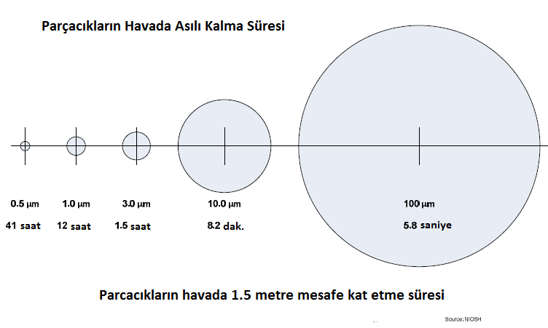
Parçacık Büyüklüğü ve Havada Asılı Kalma Süresi
 | Parçacık büyüklüğü, Mikron
Masa Tuzu | 100
Toz Şeker | 450-600
Kum | 50+
Bebek Pudrası | 10
İnsan saçı | 40-300
Un | 1-100
500 mikron altı parçacık büyüklüğü ‘toz’ sınıfına girer
Yanıcı tozlarda parçacık büyüklüğü azaldıkça patlama riski artar
Notes:
Explosion protection addresses both the vessel and the interconnection to other plant items:
Starting with vessel protection, there are three main means. First we have containment whereby the plant is made very strong such that it can withstand the maximum pressure generated by an unmitigated explosion event ~10 bar. This is an expensive option and in the case of large vessels is not pratical.
Explosion suppression, where the majority of our business lies, relies on early detection of an explosion and then the rapid deployment of suppressant, such that the explosion pressure is reduced below the strength of the plant.
Finally we have explosion venting, which is effectively a weak panel in the vessel which yields at low pressure allowing the release of product and flame. The photo shows efficacious deployment of venting to protect a bag filter, but as you can see results in a very large fireball being ejected from the vessel. This fireball obviously causes a risk to personnel and the possibility of post explosion fires and consequent explosion occurrences in other plant.
The solution here in the case for venting and suppression determines the hardware count and the reduced explosion pressure, Pred.
These techniques are well understood and have been deployed in the field for over 30 years.

Slide 32
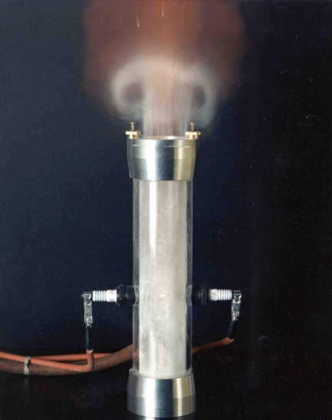
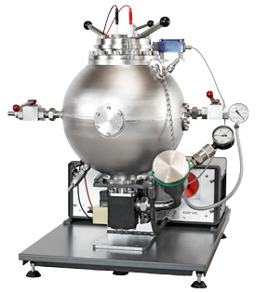
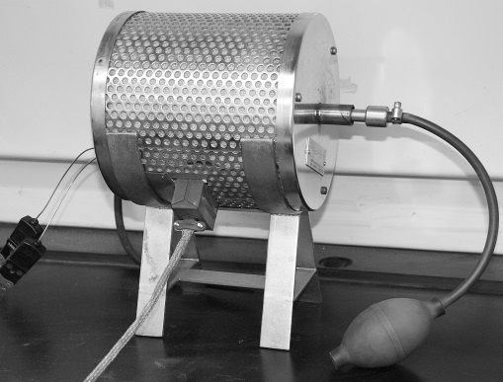

Patlayıcı Tozların Özellikleri
Go/No Go
BZ Sınıfı (yanma hızı)
Toz bulutu reaktivitesi(Pmax and Kst), ASTM E1226
Toz bulutunun minimum alevlenme sıcaklığı (AITc), ASTM E1491
Toz tabakası min alevlenme sıcaklığı (AITl), ASTM E2021
Toz bulutunun minimum tutuşma enerjisi (MIE), ASTM E2019
Minimum patlayabilir toz bulutu konstantrasyonu (MEC), ASTM E1515
Minimum oksijen konstantrasyonu (MOC), ASTM E2931
İçten yanma Onset Sıcaklığı (UN Metodu)
MIE Test Ekipmanı
20lt Kuhner (Kst, Pmax, MEC, MOC)
BAM Fırını
AITc Test Ekipmanı
Notes:
Explosion protection addresses both the vessel and the interconnection to other plant items:
Starting with vessel protection, there are three main means. First we have containment whereby the plant is made very strong such that it can withstand the maximum pressure generated by an unmitigated explosion event ~10 bar. This is an expensive option and in the case of large vessels is not pratical.
Explosion suppression, where the majority of our business lies, relies on early detection of an explosion and then the rapid deployment of suppressant, such that the explosion pressure is reduced below the strength of the plant.
Finally we have explosion venting, which is effectively a weak panel in the vessel which yields at low pressure allowing the release of product and flame. The photo shows efficacious deployment of venting to protect a bag filter, but as you can see results in a very large fireball being ejected from the vessel. This fireball obviously causes a risk to personnel and the possibility of post explosion fires and consequent explosion occurrences in other plant.
The solution here in the case for venting and suppression determines the hardware count and the reduced explosion pressure, Pred.
These techniques are well understood and have been deployed in the field for over 30 years.

Slide 33
Patlayıcı Toz St Sınıflandırılması
ST Sınıfı
K
Değeri
st
ST - 1
1 -200 (orta)
ST - 2
201 – 300 (şidetli)
ST - 3
301 and above (çok şidetli)
Madde | Medyan Çap mikron | Kst Bar.m/sec | Pmax Bar | MEC g/m3
Mısır tozu | 28 | 75 | 9 | 60
Odun | 59 | 146 | 8 | 70
Şeker | 41 | 154 | 8 | 60
Toz Boya | 20 |  | 7 | 30
Linyit | 32 | 151 | 10 | 60
REF – NFPA 68, CRC
PATLAMA KORUNMA SİSTEM TASARIMINDA GEREKLİDİR !!!!
Notes:
Explosion protection addresses both the vessel and the interconnection to other plant items:
Starting with vessel protection, there are three main means. First we have containment whereby the plant is made very strong such that it can withstand the maximum pressure generated by an unmitigated explosion event ~10 bar. This is an expensive option and in the case of large vessels is not pratical.
Explosion suppression, where the majority of our business lies, relies on early detection of an explosion and then the rapid deployment of suppressant, such that the explosion pressure is reduced below the strength of the plant.
Finally we have explosion venting, which is effectively a weak panel in the vessel which yields at low pressure allowing the release of product and flame. The photo shows efficacious deployment of venting to protect a bag filter, but as you can see results in a very large fireball being ejected from the vessel. This fireball obviously causes a risk to personnel and the possibility of post explosion fires and consequent explosion occurrences in other plant.
The solution here in the case for venting and suppression determines the hardware count and the reduced explosion pressure, Pred.
These techniques are well understood and have been deployed in the field for over 30 years.

Slide 34
Toz Malzemelerin Patlama Özellikleri
 | Minimum Alevlenme Sıcaklığı, MIT [ºC] | Minimum Alevlenme Enerjisi, MIE [mJ] | Alt Patlama Sınırı, MEC [g/m³] | Maksimum Patlama Basıncı, P_{max} [bar] | Maksimum basınç artış hızı, K_{st} [bar.m/s] | ST Sınıfı
KULLANIMI | Güvenli proses sıcaklığı, risk analizi | Risk Analizleri, elektrostatik kontroller | ZONE belirlenmesi | P.K sistem tasarımı, patlama etkisi | P.K. Sistem tasarımı | -
Kömür | 525 | 110 | 60 | 9.2 | 129 | 1
Petkok | 670 | 1000 | 125 | 7.6 | 47 | 1
Linyit | 425 | 160 | 60 | 10 | 151 | 1
Mısır | 400 | 40 | 45 | 6.55 | 137 | 1
Mısır Koçanı | 400 | 40 | 30 | 7.6 | 115 | 1
Mısır Nişastası | 380 | 20 | 40 | 7.9 | 206 | 2
Pamuk Linteri | 520 | 192 | 500 | 3.3 | 3.5 | 1
Tahıl, karışık | 430 | 30 | 55 | 7.9 | 126 | 1
Pirinç | 440 | 40 | 45 | 6.4 | 82 | 1
Şeker | 350 | 30 | 35 | 6.3 | 115 | 1
Buğday | 480 | 60 | 55 | 7.1 | 82 | 1
Ref NFPA 68, 61, 499
UYARI – Yukarıdaki değerler , tozun parçacık büyüklüğü ve rutubet oranına göre değişir

Slide 35
İçten Yanma – Malzeme Birikimi ve Alevlenme İlişkisi
100degC

Slide 36
MIE Alevlenme Enerjisi ve Risk Analizi İlişkisi
MIE | Tozları Alevlendirme Olasılığı, Pign
0 < mie < 10mj | 100%
10 < mie < 100mj | 10%
100mj < mie | 1%
Sıcak iş, rulman sürtünmesi, kıvılcım, vs | 100%
ref AICHE CCPS

Slide 37
Malzeme bilgisi proses risk analizinde nerelerde kullanılır?
Proses / Test | Go/No Go | MIE (mJ) | AIT_toz bulutu, C | AIT_ toz tabakası, C | Kst (bar.m/sec) | MOC (%) | MEC (g/m3) | İçten Yanma (degC) | Volume Resistivity | Chargeability
Malzeme transfer/ boşaltma | X | X |  |  |  |  |  |  | X | X
Eleme | X | X |  |  |  |  |  |  | X | X
Karıştırma (tumble/double cone blending) | X | X |  |  | X | X | X |  | X | X
Ribbon Blending | X | X | X | X |  |  |  |  | X | X
Öğütme (değirmenler) | X | X | X | X | X | X |  | X | X | X
Jet değirmenler | X | X |  |  | X | X |  |  | X | X
Spray/FB/Flash/Döner Kurutucu | X | X | X | X | X |  | X | X | X | X
Bantlı Kurutucular | X | X |  |  |  |  |  | X
Pünematik Taşıma | X | X |  |  |  |  | X |  | X | X
Helezon/Vidalı Taşıma ve dönen ekipmanlar | X | X |  |  |  |  | X |  | X | X
Hoper / Silo /depolama ekipmanlar ve transferleri | X | X |  |  | X |  | X | X | X | X
Toz Toplama ve Hava-Toz Ayırştırma | X | X |  |  | X |  |  |  | X | X
Elektrikli ekipman sınıflandırılması |  |  | X | X

Slide 38
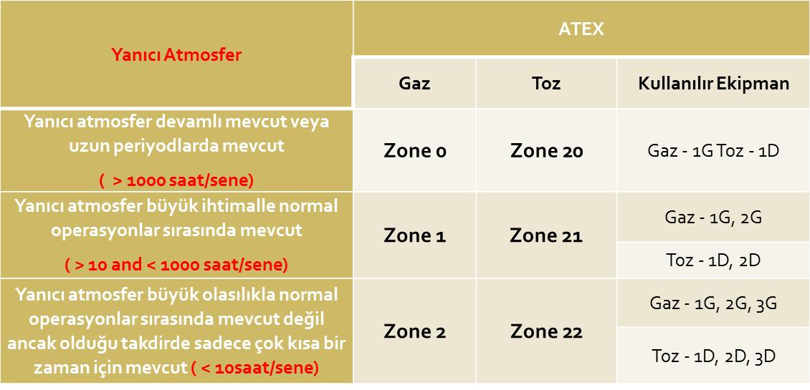
Tehlikeli Bölge / ZONE Sınıfları (TOZ)
Notes:
Explosion protection addresses both the vessel and the interconnection to other plant items:
Starting with vessel protection, there are three main means. First we have containment whereby the plant is made very strong such that it can withstand the maximum pressure generated by an unmitigated explosion event ~10 bar. This is an expensive option and in the case of large vessels is not pratical.
Explosion suppression, where the majority of our business lies, relies on early detection of an explosion and then the rapid deployment of suppressant, such that the explosion pressure is reduced below the strength of the plant.
Finally we have explosion venting, which is effectively a weak panel in the vessel which yields at low pressure allowing the release of product and flame. The photo shows efficacious deployment of venting to protect a bag filter, but as you can see results in a very large fireball being ejected from the vessel. This fireball obviously causes a risk to personnel and the possibility of post explosion fires and consequent explosion occurrences in other plant.
The solution here in the case for venting and suppression determines the hardware count and the reduced explosion pressure, Pred.
These techniques are well understood and have been deployed in the field for over 30 years.

Slide 39
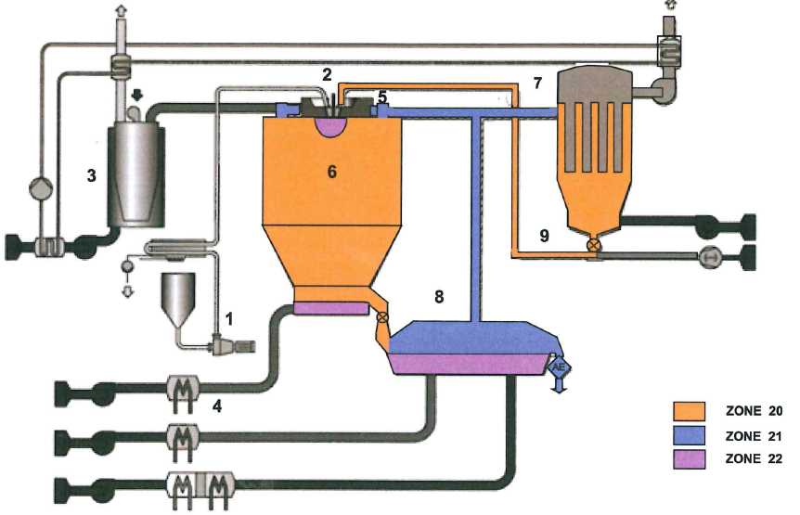
ZONE Sınıfı Örnekleri – Sprey Kurutucu
Jet Filtre
Sprey
Kurutucu
FBD
Ref VDI 2263 7.1
Notes:
Explosion protection addresses both the vessel and the interconnection to other plant items:
Starting with vessel protection, there are three main means. First we have containment whereby the plant is made very strong such that it can withstand the maximum pressure generated by an unmitigated explosion event ~10 bar. This is an expensive option and in the case of large vessels is not pratical.
Explosion suppression, where the majority of our business lies, relies on early detection of an explosion and then the rapid deployment of suppressant, such that the explosion pressure is reduced below the strength of the plant.
Finally we have explosion venting, which is effectively a weak panel in the vessel which yields at low pressure allowing the release of product and flame. The photo shows efficacious deployment of venting to protect a bag filter, but as you can see results in a very large fireball being ejected from the vessel. This fireball obviously causes a risk to personnel and the possibility of post explosion fires and consequent explosion occurrences in other plant.
The solution here in the case for venting and suppression determines the hardware count and the reduced explosion pressure, Pred.
These techniques are well understood and have been deployed in the field for over 30 years.

Slide 40
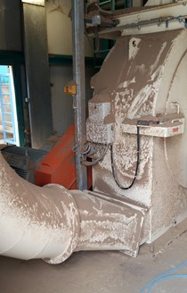
Aşırı Toz Birikimi – ZONE 22 Alanlar
ZONE 22 Çalışma Alanı Örnekleri
Notes:
Explosion protection addresses both the vessel and the interconnection to other plant items:
Starting with vessel protection, there are three main means. First we have containment whereby the plant is made very strong such that it can withstand the maximum pressure generated by an unmitigated explosion event ~10 bar. This is an expensive option and in the case of large vessels is not pratical.
Explosion suppression, where the majority of our business lies, relies on early detection of an explosion and then the rapid deployment of suppressant, such that the explosion pressure is reduced below the strength of the plant.
Finally we have explosion venting, which is effectively a weak panel in the vessel which yields at low pressure allowing the release of product and flame. The photo shows efficacious deployment of venting to protect a bag filter, but as you can see results in a very large fireball being ejected from the vessel. This fireball obviously causes a risk to personnel and the possibility of post explosion fires and consequent explosion occurrences in other plant.
The solution here in the case for venting and suppression determines the hardware count and the reduced explosion pressure, Pred.
These techniques are well understood and have been deployed in the field for over 30 years.

Slide 41
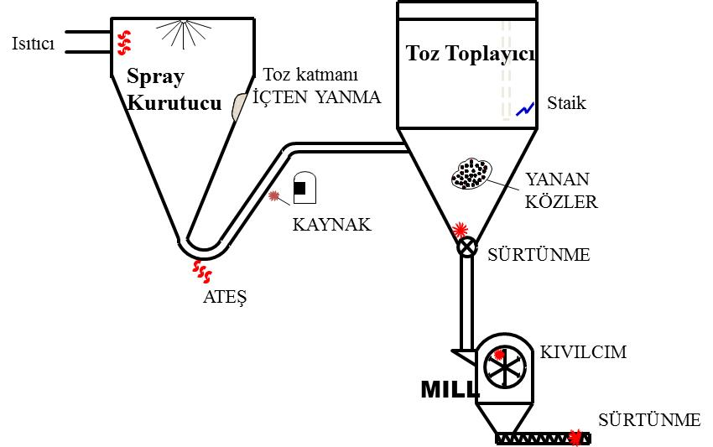
Alev Kaynakları- EN1127-1
EN1127-1 Alev Kaynakları Örnekleri
Elektrostatik alevlenme
Mekanik Kıvılcımlar
Sürtünme
Döner ekipmanda aşırı ısınma
Yabancı malzeme
Çarpma
Ekipmanda kırılma/bozulma
Sıcak iş izinleri
Toprak eksikliği
Ortama uygun olmayan elektrikli ekipman
Egzotermik reaksiyon
İçten yanma
Vs....
Notes:
Explosion protection addresses both the vessel and the interconnection to other plant items:
Starting with vessel protection, there are three main means. First we have containment whereby the plant is made very strong such that it can withstand the maximum pressure generated by an unmitigated explosion event ~10 bar. This is an expensive option and in the case of large vessels is not pratical.
Explosion suppression, where the majority of our business lies, relies on early detection of an explosion and then the rapid deployment of suppressant, such that the explosion pressure is reduced below the strength of the plant.
Finally we have explosion venting, which is effectively a weak panel in the vessel which yields at low pressure allowing the release of product and flame. The photo shows efficacious deployment of venting to protect a bag filter, but as you can see results in a very large fireball being ejected from the vessel. This fireball obviously causes a risk to personnel and the possibility of post explosion fires and consequent explosion occurrences in other plant.
The solution here in the case for venting and suppression determines the hardware count and the reduced explosion pressure, Pred.
These techniques are well understood and have been deployed in the field for over 30 years.

Slide 42
Alev Kaynakları- EN1127-1
ALEV KAYNAKLARI FORMU
PROSES ADI: | Toz MIE, mJ | Toz AIT , ºC | Tarih: | Dolduran:
OLASI KAYNAKLAR (EN1127) |  |  | ALAKALI (EVET/HAYIR) | TOZU ALEVLENDİRME OLASILIĞI (sebepleri ile)
Sıcak Yüzeyler
Atev ve sıcak gazlar (sıcak parçacıklarıda dahil et)
Mekanik oluşan kıvılcım kaynakları
Elektrkli Ekipman
Kontrolsüz Elektrik Akımları, katodik korozyon koruması
Statik Elektrik
Korona Boşalımı
Brush Boşalımı
İlerleyen Brush Boşalımı
Cone Boşalımı
Kıvılcım Boşalımı
Yıldırım
Radyo Frekansı 10^4 Hz - 3x10^11 Hz
Elekktromanyetik Dalgalar 3x10^11-10^15 Hz arasi
Iyonlaşma Radyasyonu
Ultrasonik kaynaklar
Adiyabatik Sıkışma ve Şok Dalgası
Ekzotermik Reaksyon ve tozun kendinden yanması
Notes:
Explosion protection addresses both the vessel and the interconnection to other plant items:
Starting with vessel protection, there are three main means. First we have containment whereby the plant is made very strong such that it can withstand the maximum pressure generated by an unmitigated explosion event ~10 bar. This is an expensive option and in the case of large vessels is not pratical.
Explosion suppression, where the majority of our business lies, relies on early detection of an explosion and then the rapid deployment of suppressant, such that the explosion pressure is reduced below the strength of the plant.
Finally we have explosion venting, which is effectively a weak panel in the vessel which yields at low pressure allowing the release of product and flame. The photo shows efficacious deployment of venting to protect a bag filter, but as you can see results in a very large fireball being ejected from the vessel. This fireball obviously causes a risk to personnel and the possibility of post explosion fires and consequent explosion occurrences in other plant.
The solution here in the case for venting and suppression determines the hardware count and the reduced explosion pressure, Pred.
These techniques are well understood and have been deployed in the field for over 30 years.

Slide 43
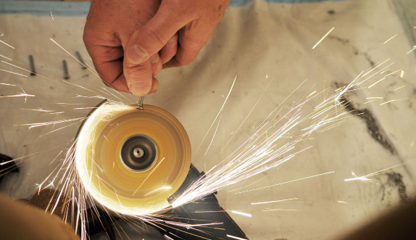
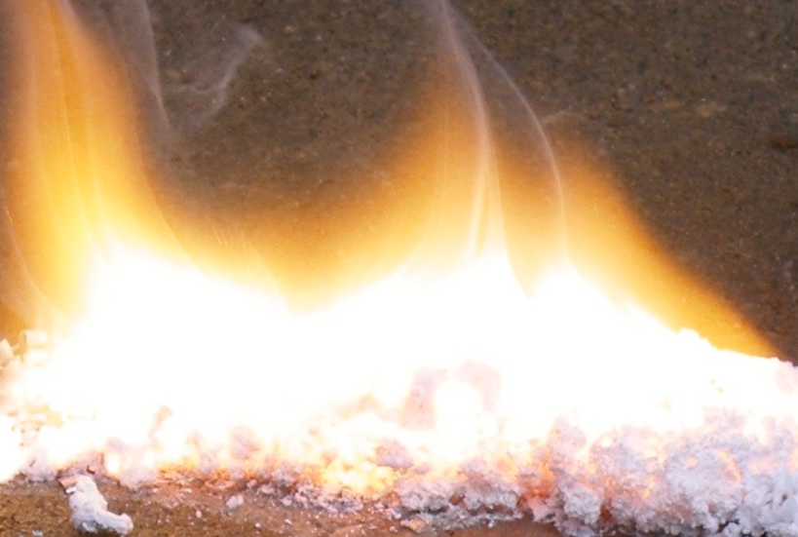
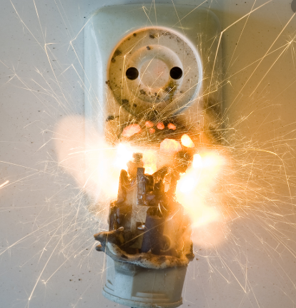
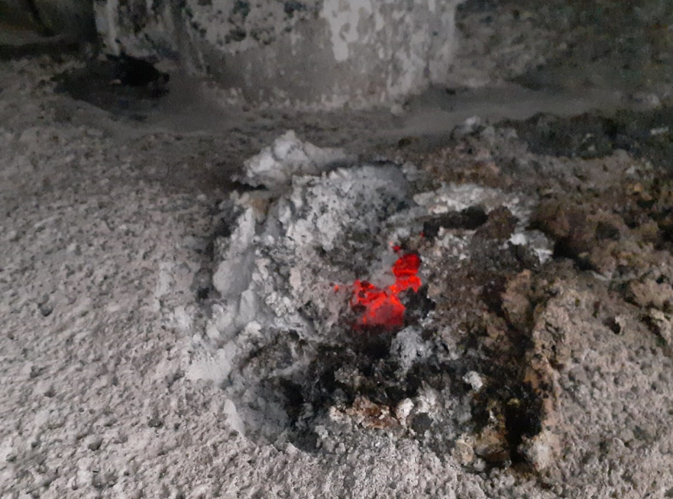
Alev Kaynakları

Slide 44
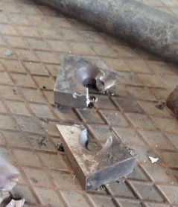
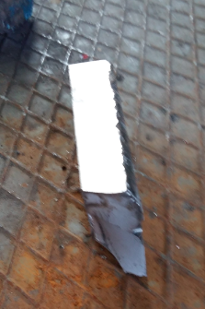
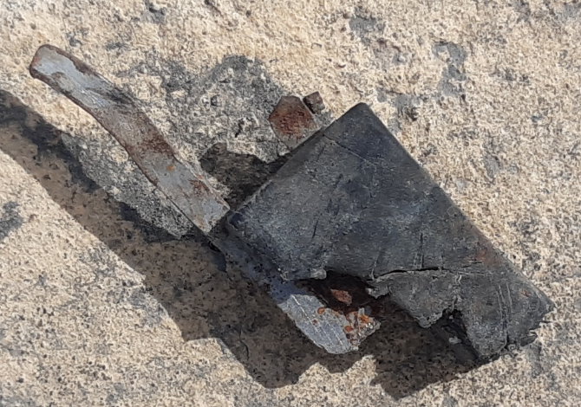
Yabancı Malzemeler
Kırılmış değrimen/shredder bıçakları
Kopmuş konveyör parçası

Slide 45
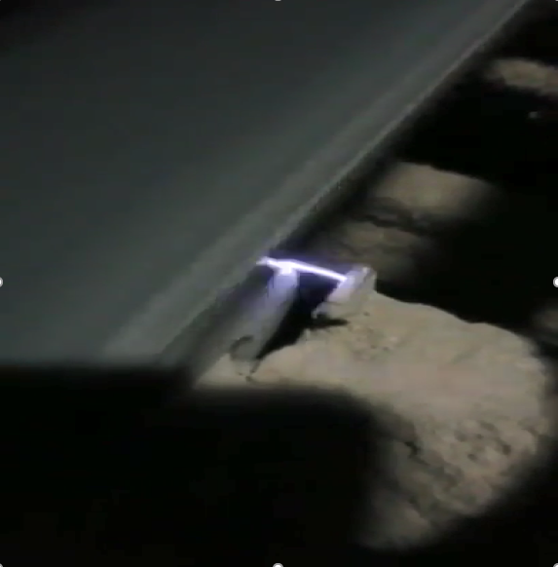
Kıvılcım - Elektrosatik Boşalım
Notes:
Explosion protection addresses both the vessel and the interconnection to other plant items:
Starting with vessel protection, there are three main means. First we have containment whereby the plant is made very strong such that it can withstand the maximum pressure generated by an unmitigated explosion event ~10 bar. This is an expensive option and in the case of large vessels is not pratical.
Explosion suppression, where the majority of our business lies, relies on early detection of an explosion and then the rapid deployment of suppressant, such that the explosion pressure is reduced below the strength of the plant.
Finally we have explosion venting, which is effectively a weak panel in the vessel which yields at low pressure allowing the release of product and flame. The photo shows efficacious deployment of venting to protect a bag filter, but as you can see results in a very large fireball being ejected from the vessel. This fireball obviously causes a risk to personnel and the possibility of post explosion fires and consequent explosion occurrences in other plant.
The solution here in the case for venting and suppression determines the hardware count and the reduced explosion pressure, Pred.
These techniques are well understood and have been deployed in the field for over 30 years.

Slide 46
Alev Kaynakları
Ref: AICHE Center for Chemical Process Safety
Notes:
Explosion protection addresses both the vessel and the interconnection to other plant items:
Starting with vessel protection, there are three main means. First we have containment whereby the plant is made very strong such that it can withstand the maximum pressure generated by an unmitigated explosion event ~10 bar. This is an expensive option and in the case of large vessels is not pratical.
Explosion suppression, where the majority of our business lies, relies on early detection of an explosion and then the rapid deployment of suppressant, such that the explosion pressure is reduced below the strength of the plant.
Finally we have explosion venting, which is effectively a weak panel in the vessel which yields at low pressure allowing the release of product and flame. The photo shows efficacious deployment of venting to protect a bag filter, but as you can see results in a very large fireball being ejected from the vessel. This fireball obviously causes a risk to personnel and the possibility of post explosion fires and consequent explosion occurrences in other plant.
The solution here in the case for venting and suppression determines the hardware count and the reduced explosion pressure, Pred.
These techniques are well understood and have been deployed in the field for over 30 years.

Slide 47
Proses Ekipmanlarında Olası Alev Kaynakları
 | Silo | Toz Toplayıcılar | Siklonlar | Mikser/Blender/Reaktör | Elek/Havalı Ayrıştırıcı | Konveyörler, elevatörler | Transfer Şutları | Değirmen/Öğütücü | Kurutucular/Kazanlar
Sürtünme |  |  |  | x | x | x |  | x
Kıvılcım | x | x |  | x | x | x |  | x | x
Kimyasal reaktivite |  |  |  | x |  |  |  |  | x
Sıcak İş | x | x | x | x | x | x | x | x | x
Kontrolsüz yakma |  |  |  |  |  |  |  |  | x
Elektrik | x | x | x | x |  | x | x | x | x
Statik Elektrik | x | x |  | x | x | x | x
Aşırı ısınma |  |  |  | x |  | x |  | x | x
Sıcak yüzeyler |  |  |  | x |  |  |  | x | x
Çarpma/yabancı cisim | x | x | x | x | x | x | x | x
İçten yanma | x |  |  |  |  |  |  |  | x
Ref: AICHE Center for Chemical Process Safety
Notes:
Explosion protection addresses both the vessel and the interconnection to other plant items:
Starting with vessel protection, there are three main means. First we have containment whereby the plant is made very strong such that it can withstand the maximum pressure generated by an unmitigated explosion event ~10 bar. This is an expensive option and in the case of large vessels is not pratical.
Explosion suppression, where the majority of our business lies, relies on early detection of an explosion and then the rapid deployment of suppressant, such that the explosion pressure is reduced below the strength of the plant.
Finally we have explosion venting, which is effectively a weak panel in the vessel which yields at low pressure allowing the release of product and flame. The photo shows efficacious deployment of venting to protect a bag filter, but as you can see results in a very large fireball being ejected from the vessel. This fireball obviously causes a risk to personnel and the possibility of post explosion fires and consequent explosion occurrences in other plant.
The solution here in the case for venting and suppression determines the hardware count and the reduced explosion pressure, Pred.
These techniques are well understood and have been deployed in the field for over 30 years.

Slide 48
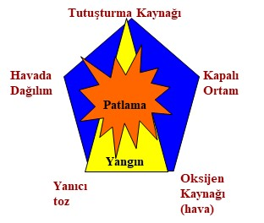
Toz Patlama Risklerini Nasıl Azaltabiliriz ?
Patlama Engelleyici Önlemler
Topraklama, Bond
Kıvılcım Algılama ve Söndürme
Dönen ekipmanlarda aşırı ısı algılama
Devir bekçisi kullanımı
Tozsuzlaştırma
Ortam Temizliği, vs
Patlama Korunma Önlemleri
İnerting sistemleri
Patlama basıncına dayanımlı ekipmanlar ve hatlar
Patlama tahliye kapakları
Patlama söndürme sistemleri
VE Patlama izolasyonu (patlama yayılma engelleme)
Notes:
Explosion protection addresses both the vessel and the interconnection to other plant items:
Starting with vessel protection, there are three main means. First we have containment whereby the plant is made very strong such that it can withstand the maximum pressure generated by an unmitigated explosion event ~10 bar. This is an expensive option and in the case of large vessels is not pratical.
Explosion suppression, where the majority of our business lies, relies on early detection of an explosion and then the rapid deployment of suppressant, such that the explosion pressure is reduced below the strength of the plant.
Finally we have explosion venting, which is effectively a weak panel in the vessel which yields at low pressure allowing the release of product and flame. The photo shows efficacious deployment of venting to protect a bag filter, but as you can see results in a very large fireball being ejected from the vessel. This fireball obviously causes a risk to personnel and the possibility of post explosion fires and consequent explosion occurrences in other plant.
The solution here in the case for venting and suppression determines the hardware count and the reduced explosion pressure, Pred.
These techniques are well understood and have been deployed in the field for over 30 years.

Slide 49
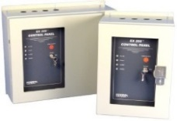
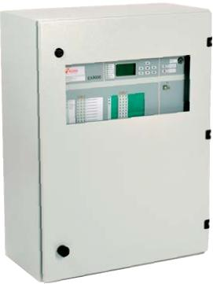













Patlama Korunma
  Explosion Suppression /
  Patlama Sönümleme
  Explosion Isolation /
  Patlama İzolasyonu
  Explosion Vents /
  Patlama Kapakları
  Engineering Services /
  Mühendislik Hizmetleri
Design /
Sistem Tasarımı
Maintenance
Bakım Hizmeti
Material Testing
Malzeme Testleri

Slide 50







Patlama Engelleme
  Spark Detection & extinguishment /
  Kıvılcım Algılama ve Söndürme
  Flame Detection/
  Alev Algılama
  CO and Smoke Detection /
  Karbon Monoksit ve Duman Algılama
  Overheat Detection /
  Makina Aşırı Isınma Algılama

Slide 51

Elektrosatik Kontroller
Notes:
Explosion protection addresses both the vessel and the interconnection to other plant items:
Starting with vessel protection, there are three main means. First we have containment whereby the plant is made very strong such that it can withstand the maximum pressure generated by an unmitigated explosion event ~10 bar. This is an expensive option and in the case of large vessels is not pratical.
Explosion suppression, where the majority of our business lies, relies on early detection of an explosion and then the rapid deployment of suppressant, such that the explosion pressure is reduced below the strength of the plant.
Finally we have explosion venting, which is effectively a weak panel in the vessel which yields at low pressure allowing the release of product and flame. The photo shows efficacious deployment of venting to protect a bag filter, but as you can see results in a very large fireball being ejected from the vessel. This fireball obviously causes a risk to personnel and the possibility of post explosion fires and consequent explosion occurrences in other plant.
The solution here in the case for venting and suppression determines the hardware count and the reduced explosion pressure, Pred.
These techniques are well understood and have been deployed in the field for over 30 years.

Slide 52





Kıvılcım Algılama ve Sönümleme
Atomize su kıvılcım söndürme
Kıvılcım/sıcak parçacık algılama,geniş spektrum, geniş açı
Kontrol paneli
Hassas Algılama
Rulman, blower,
Dönen ekipman aşırı ısınma algılama
300oC Altı Isıda sıcak parçacık algılama

Slide 53

Kıvılcım Algılama ve Sönümleme

Slide 54

IEP Uygulamalar – Filtreler

Slide 55

Uygulamalar - Tozsuzlaştırma

Slide 56



Uygulamalar – Pelet Presleri

Slide 57

Uygulamalar – Silo ve Bunkerler

Slide 58

Patlama Korunma Sistemi Seçimi
Notes:
Explosion protection addresses both the vessel and the interconnection to other plant items:
Starting with vessel protection, there are three main means. First we have containment whereby the plant is made very strong such that it can withstand the maximum pressure generated by an unmitigated explosion event ~10 bar. This is an expensive option and in the case of large vessels is not pratical.
Explosion suppression, where the majority of our business lies, relies on early detection of an explosion and then the rapid deployment of suppressant, such that the explosion pressure is reduced below the strength of the plant.
Finally we have explosion venting, which is effectively a weak panel in the vessel which yields at low pressure allowing the release of product and flame. The photo shows efficacious deployment of venting to protect a bag filter, but as you can see results in a very large fireball being ejected from the vessel. This fireball obviously causes a risk to personnel and the possibility of post explosion fires and consequent explosion occurrences in other plant.
The solution here in the case for venting and suppression determines the hardware count and the reduced explosion pressure, Pred.
These techniques are well understood and have been deployed in the field for over 30 years.

Slide 59


Patlama Tahliye
Standart patlama kapağı ve
patlama izolasyonu
Alevsiz patlama kapağı ve
patlama izolasyonu
Notes:
Explosion protection addresses both the vessel and the interconnection to other plant items:
Starting with vessel protection, there are three main means. First we have containment whereby the plant is made very strong such that it can withstand the maximum pressure generated by an unmitigated explosion event ~10 bar. This is an expensive option and in the case of large vessels is not pratical.
Explosion suppression, where the majority of our business lies, relies on early detection of an explosion and then the rapid deployment of suppressant, such that the explosion pressure is reduced below the strength of the plant.
Finally we have explosion venting, which is effectively a weak panel in the vessel which yields at low pressure allowing the release of product and flame. The photo shows efficacious deployment of venting to protect a bag filter, but as you can see results in a very large fireball being ejected from the vessel. This fireball obviously causes a risk to personnel and the possibility of post explosion fires and consequent explosion occurrences in other plant.
The solution here in the case for venting and suppression determines the hardware count and the reduced explosion pressure, Pred.
These techniques are well understood and have been deployed in the field for over 30 years.

Slide 60


Patlama Tahliye / Vent
TS EN 14797:2006 Patlama Tahliye Tertibatları (Explosion Venting Devices)
  Fonkisyon ve mekanik bütünlük testleri
  Verimlilik testleri
  Statik açılma basıncı testleri
  Sıcaklık etkisi testleri
  Spesifik ağırık etkisi testleri
  Etiketleme standartları (Bölüm 10.3.2)
    Üretici ad ve adresi
    CE İşareti (İlgili standardına uygun ebatlarda)
    EX işareti (İlgili standardına uygun ebatlarda)
    Gerekli uyarılar (basmayınız vs.)
    Uygulanan Standart
    Model ve statik açılma basıncı bilgileri
Üretici firmanın da ATEX üretici onayı olmalı

Slide 61
Patlama Tahliye / Patlama Kapakları
Basit ve hesaplı uygulama
Ekipman üzerin yerleştirilen zayıf membran ~ 0.1bar açılma
Sadece basıncı tahliye eder– Alevi yok etmez
Patlama sonrası yangın oluşabilir
Etrafında güvenli alan olmalı- alevsizler dahil
Tahliye kapağı açıklığından alev topu çıkışı ~ 8 x V
Basınç-Zaman Grafiği
Basınç
P_{max}
Patlama kapağı yok
Ekipman dayanımı
P _{red} – İndirgenmiş basınç
P_{stat} –Kapak açılış basıncı
Patlama kapağı var
Zaman

Slide 62






Patlama Tahliye Kapakları
Patlama Kapakları
Standart
Alevsiz
GE → Domed, vakuma uygun
IndoorVent IV
Yuvarlak Panel
GE → Domed, vakuma uygun
IV8
Yüksek Verimli
KE → Düz, flanş gerekli
EVN 2.0
Uygulama Kolaylığı
Açılır-kapanır
KER → Düz, flanş dahil
Notes:
Explosion protection addresses both the vessel and the interconnection to other plant items:
Starting with vessel protection, there are three main means. First we have containment whereby the plant is made very strong such that it can withstand the maximum pressure generated by an unmitigated explosion event ~10 bar. This is an expensive option and in the case of large vessels is not pratical.
Explosion suppression, where the majority of our business lies, relies on early detection of an explosion and then the rapid deployment of suppressant, such that the explosion pressure is reduced below the strength of the plant.
Finally we have explosion venting, which is effectively a weak panel in the vessel which yields at low pressure allowing the release of product and flame. The photo shows efficacious deployment of venting to protect a bag filter, but as you can see results in a very large fireball being ejected from the vessel. This fireball obviously causes a risk to personnel and the possibility of post explosion fires and consequent explosion occurrences in other plant.
The solution here in the case for venting and suppression determines the hardware count and the reduced explosion pressure, Pred.
These techniques are well understood and have been deployed in the field for over 30 years.

Slide 63


Filtrelerde Patlama Kapak Kullanımı
2018 © IEP Technologies – izinsiz kopyalanmaz

Slide 64


Elevatörlerde Patlama Kapağı Kullanımı

Slide 65


Patlama Tahliye Kapakları - Elevatörler
NFPA 61
VDI 2263

Slide 66

Silolarda Patlama Kapağı Kullanımı

Slide 67


Alevsiz Patlama Kapağı
EVN Alevsiz Patlama Kapağı (Çok Kullanımlı Tasarım)

Slide 68


IV8 Alevsiz Patlama Kapağı

Slide 69




Alevsiz Patlama Kapakları -VDI 2263 8.1

Slide 70




100% Pasif Korunma Çözümü
Toz Emiş Hattı üzerinde Flap
Temiz hava çıkış hattı üzeri Ventex
EVN Alevsiz Patlama Kapağı

Slide 71


Patlama Söndürme
Aktif sistem
Kapalı alanlar
Veya tahliye kapakları kullanılmamadığı zamanlar
Notes:
Explosion protection addresses both the vessel and the interconnection to other plant items:
Starting with vessel protection, there are three main means. First we have containment whereby the plant is made very strong such that it can withstand the maximum pressure generated by an unmitigated explosion event ~10 bar. This is an expensive option and in the case of large vessels is not pratical.
Explosion suppression, where the majority of our business lies, relies on early detection of an explosion and then the rapid deployment of suppressant, such that the explosion pressure is reduced below the strength of the plant.
Finally we have explosion venting, which is effectively a weak panel in the vessel which yields at low pressure allowing the release of product and flame. The photo shows efficacious deployment of venting to protect a bag filter, but as you can see results in a very large fireball being ejected from the vessel. This fireball obviously causes a risk to personnel and the possibility of post explosion fires and consequent explosion occurrences in other plant.
The solution here in the case for venting and suppression determines the hardware count and the reduced explosion pressure, Pred.
These techniques are well understood and have been deployed in the field for over 30 years.

Slide 72

Patlama Söndürme
Ref – GMP proses, filtre patlama korunması
Notes:
Explosion protection addresses both the vessel and the interconnection to other plant items:
Starting with vessel protection, there are three main means. First we have containment whereby the plant is made very strong such that it can withstand the maximum pressure generated by an unmitigated explosion event ~10 bar. This is an expensive option and in the case of large vessels is not pratical.
Explosion suppression, where the majority of our business lies, relies on early detection of an explosion and then the rapid deployment of suppressant, such that the explosion pressure is reduced below the strength of the plant.
Finally we have explosion venting, which is effectively a weak panel in the vessel which yields at low pressure allowing the release of product and flame. The photo shows efficacious deployment of venting to protect a bag filter, but as you can see results in a very large fireball being ejected from the vessel. This fireball obviously causes a risk to personnel and the possibility of post explosion fires and consequent explosion occurrences in other plant.
The solution here in the case for venting and suppression determines the hardware count and the reduced explosion pressure, Pred.
These techniques are well understood and have been deployed in the field for over 30 years.

Slide 73



Dinamik Patlama Basıncı Algılama

Slide 74

Örnek: Kurutucular

Slide 75


Örnek: Kurutucular

Slide 76


Örnek: Değirmenler/Transfer Hatları

Slide 77


Patlama İzolasyonu
İhtiva, patlama kapakları veya söndürme uygulamalarının tamamı izolasyon sistemleri ile tamamlanır
Bağlantılı ekipmanlar arası alev geçişi patlama etkisini arttırır– Flame Jet Ignition (İSG 6331 Madde 5)
REF: NFPA 68-98 Bölüm 3-6.7 ve VDI 2263 Bölüm 4, NFPA 654-97 Bölüm 3-1.2

Slide 78









Patlama İzolasyonu
Pasif İzolasyon
(ör. Detektör veya kontrol sistemi ihtiyacı yok)
  Aktif İzolasyon
  (ör. HRD söndürme tüpleri, hızlı slide vanalar)
IsoFlap

Slide 79

Patlama İzolasyonu

Slide 80



Patlama İzolasyonu
Mekanik İzolasyon - Flap Vana
Aktif Kimyasal İzolasyon
Aktif Mekanik İzolasyon
Slide Vana

Slide 81

Patlama Korunma Olmadığı Zaman

Slide 82
Teşekkürler, Emre Ergun
Emre.Ergun@Hoerbiger.com
0533-457-4412

Slide 83
EKLER

Slide 84
Kanunlar ve Standartlar
Çalışanların Patlayıcı Ortamların Tehlikelerinden Korunması Hakkında Yönetmelik (ISG 6331)
Resmi Gazete 28633 (6331 Numaralı İSG Kanunu Madde 5)
(1) İşveren, patlamaların önlenmesi ve bunlardan korunmayı sağlamak amacıyla, yapılan işlemlerin doğasına uygun olan teknik ve organizasyona yönelik önlemleri alır. Bu önlemler alınırken aşağıda belirtilen temel ilkelere ve verilen öncelik sırasına uyulur;
a) Patlayıcı ortam oluşmasını önlemek,
b) Yapılan işlemlerin doğası gereği patlayıcı ortam oluşmasının önlenmesi mümkün değilse patlayıcı ortamın tutuşmasını önlemek,
c) Çalışanların sağlık ve güvenliklerini sağlayacak şekilde patlamanın zararlı etkilerini azaltacak önlemleri almak.
(2) Birinci fıkrada belirtilen önlemler, gerektiğinde patlamanın yayılmasını önleyecek tedbirlerle birlikte alınır. Alınan bu tedbirler düzenli aralıklarla ve işyerindeki önemli değişikliklerden sonra yeniden gözden geçirilir.

Slide 85
DIN/EN Standardları
TS/EN 60079-10-1Patlayıcı ortamlar- Bölüm 10-1: Alanların sınıflandırılması - Patlayıcı gaz ortamları
TS/EN 60079-10-2 Patlayıcı ortamlar- Bölüm 10-2: Tehlikeli bölgelerin sınıflandırılması-Yanıcı toz atmosferler
DIN EN 1127-1 Explosive atmospheres, explosion protection Part 1: Fundamental principles and methods
DIN EN 60079 Installation of electrical equipment in hazardous areas, Repair and maintenance of operators intended for use in hazardous areas
VDI 2263 Dust fires and dust explosions Hazards – Assessment – Protection measures
DIRECTIVE 1999/92/EC OF THE EUROPEAN PARLIAMENT AND OF THE COUNCIL of 16 December 1999 on minimum requirements for improving the safety and health protection of workers potentially at risk from explosive atmospheres (15th individual Directive within the meaning of Article 16(1) of Directive 89/391/EEC)

Slide 86


VDI Standardları

Slide 87
NFPA Standardları
  NFPA 652 Yanıcı/Parlayıcı Tozlar ve Toz Tehlike Analizleri
  NFPA 654 Yanabilir/patlayabilir tozlar ve parçacıkları işleyen tesisler
  NFPA 664 Odun işleyen prosesler
  NFPA 61 Gıda ve Tahıl Tozları işleyen prosesler
  NFPA 484 Metal tozları
  NFPA 30B Aerosol ürünleri
  NFPA 68 Patlama kapakları
  NFPA 69 Patlamaları Engelleyici Sistemler
  NFPA 85 Kazan ve Yakma Sistemleri (kömür)
(c) 2016 IEP Technologies A.S. - İzinsiz Kopyalanmaz
Notes:
NFPA issues a number of national consensus standards that address the hazards of combustible dust. For example, NFPA 654, Standard for the Prevention of Fire and Dust Explosions from the Manufacturing, Processing, and Handling of Combustible Particulate Solids, addresses the hazards of combustible dust in a general manner. Specific industries are excluded from NFPA 654, but are covered by other NFPA standards, including NFPA 61, Standard for the Prevention of Fires and Dust Explosions in Agricultural and Food Processing Facilities; NFPA 484, Standard for Combustible Metals; NFPA 655, Standard for Prevention of Sulfur Fires and Explosions; and NFPA 664, Standard for the Prevention of Fires and Explosions in Wood Processing and Woodworking Facilities. These five NFPA combustible dust standards have mandatory secondary references to a large number of other standards. The 2006 edition of NFPA 654 mandates compliance with 36 other NFPA standards. These 36 secondary references, in turn, reference additional standards. In effect, no one standard comprehensively addresses the hazards of combustible dust, which may pose difficulties for some employers trying to develop programs to mitigate combustible dust hazards. In addition, the provisions of these five NFPA standards differ, which may add to these difficulties. Some elements of protection are addressed in some standards but not in others; other elements are addressed in different ways in the various standards. For example, NFPA 61, 484, and 654 contain provisions for drive belts, while NFPA 655 and 664 have no provisions directly addressing drive belts. In addition to the NFPA standards listed above, NFPA issues a number of standards that cover the design and installation of protection systems specific to deflagration and explosion hazards, including combustible dust. Two of these standards are NFPA 68, Standard on Explosions Protection by Deflagration Venting, and NFPA 69, Standard on Explosion Prevention Systems

Slide 88




FM Datasheets
Notes:
NFPA issues a number of national consensus standards that address the hazards of combustible dust. For example, NFPA 654, Standard for the Prevention of Fire and Dust Explosions from the Manufacturing, Processing, and Handling of Combustible Particulate Solids, addresses the hazards of combustible dust in a general manner. Specific industries are excluded from NFPA 654, but are covered by other NFPA standards, including NFPA 61, Standard for the Prevention of Fires and Dust Explosions in Agricultural and Food Processing Facilities; NFPA 484, Standard for Combustible Metals; NFPA 655, Standard for Prevention of Sulfur Fires and Explosions; and NFPA 664, Standard for the Prevention of Fires and Explosions in Wood Processing and Woodworking Facilities. These five NFPA combustible dust standards have mandatory secondary references to a large number of other standards. The 2006 edition of NFPA 654 mandates compliance with 36 other NFPA standards. These 36 secondary references, in turn, reference additional standards. In effect, no one standard comprehensively addresses the hazards of combustible dust, which may pose difficulties for some employers trying to develop programs to mitigate combustible dust hazards. In addition, the provisions of these five NFPA standards differ, which may add to these difficulties. Some elements of protection are addressed in some standards but not in others; other elements are addressed in different ways in the various standards. For example, NFPA 61, 484, and 654 contain provisions for drive belts, while NFPA 655 and 664 have no provisions directly addressing drive belts. In addition to the NFPA standards listed above, NFPA issues a number of standards that cover the design and installation of protection systems specific to deflagration and explosion hazards, including combustible dust. Two of these standards are NFPA 68, Standard on Explosions Protection by Deflagration Venting, and NFPA 69, Standard on Explosion Prevention Systems

